Slide 1

Denver Metro RTD Rail at 30:
Will state land use reforms and new funding sources save its low ridership?
October 24, 2025
ACSP Annual Conference, 2025
Carrie Makarewicz, PhD, Dani Slabaugh, PhD, Jack Suva-Urwin, Mark Schenberger

Slide 2
The problem: “Bringing Riders to the Station”

Slide 3
Ridership Progress
Journey to Work by Transit in relation to Population Growth (Census /ACS 1990 to 2023)
 | 1990 | 2000 | 2010 | 2019-2023 w/o Boulder | 2019-2023 w/ Boulder
Population | 1,980,140 | 2,581,506 | 3,037,053 | 2,977,085 | 3,305,402
Commuters by Transit | 40,622 | 58,471 | 66,336 | 44,910 | 50,482
% Commute by Transit | 2.1% | 2.3% | 2.2% | 2.8%, | 1.5%
RTD Ridership 2022-2024 (RTD)
Ridership | 2022 | 2023 | 2024 | % Change 2022-2024
Annual boardings | 61,602,568 | 65,175,290 | 65,230,065 | 6%
Bus boardings | 35,479,174 | 41,009,241 | 42,689,708 | 20%
Access-a-Ride | 529,448 | 543,619 | 1,215,216 | 130%
Rail Boardings | 21,540,452 | 21,318,629 | 19,493,133 | -10%
Light rail | 13,604,641 | 12,740,358 | 11,161,755 | -18%
Commuter rail (A-line to DEN) | 7,935,811 | 8,578,271 | 8,331,378 | 5%
Denver-Aurora-Greely CO CSA Pop. | 3,663,515 | 3,691,404 | 3,750,519 | 2%

Slide 4
How does the Denver region compare to peer systems?
Means of Transport to Work by Transit in 6 Regions with New Rail Systems
(Census ACS 2019 – 2023)
 | Phoenix-Mesa-Chandler, AZ |  | Los Angeles-Long Beach-Anaheim, CA |  | Denver-Aurora-Centennial, CO |  | Minneapolis-St. Paul-Bloomington, MN-WI |  | Charlotte-Concord-Gastonia, NC-SC |  | Salt Lake City-Murray, UT
All Workers | 32,057 | 1.4% | 235,424 | 3.8% | 44,910 | 2.8% | 54,223 | 2.9% | 15,321 | 1.3% | 15,670 | 2.4%
Renters (% of All) |  | 55% |  | 70% |  | 54% |  | 47% |  | 51% |  | 48%

Slide 5
Research Questions
Why is ridership so low?
What will it take to improve ridership?

Slide 6
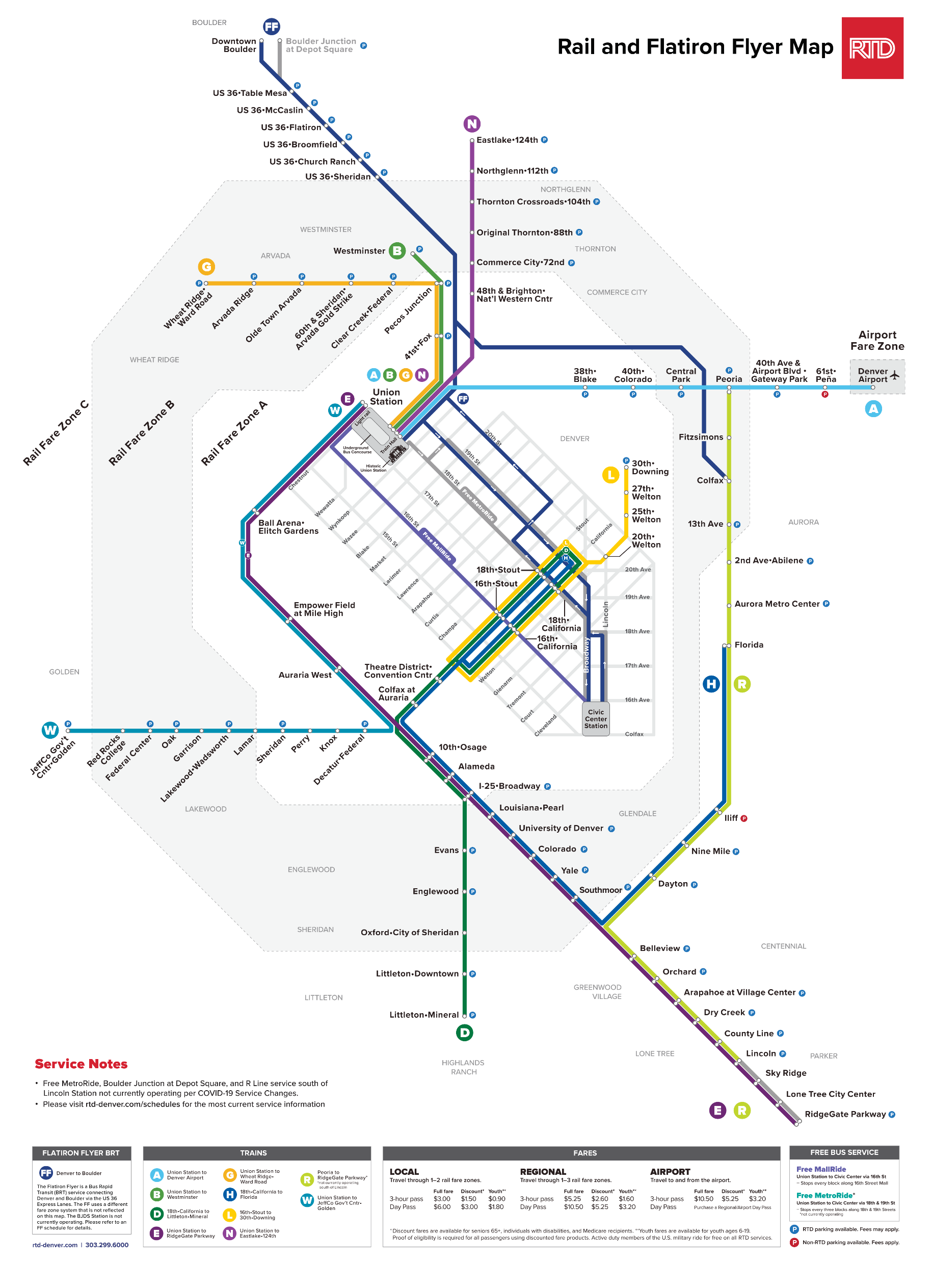
Background Context: Adding Boulder and the Flat Iron Flyer “BRT”
6.25 core counties in Denver MSA + Boulder MSA: 3.3M people
RTD’s service area: 2,345 sq. mi. 41 cities, 8 counties.
RTD’s Light Rail + BRT system: 84 stations, 10 lines, and 115 miles of track. +
First line opened in 1994 = 30 y.o, but most are 6 to 12 y.o.
2016
2020
2016
2019
2016
3rd line, 2013
2017
2nd line, 2002
1st line, 1994
2019

Slide 7
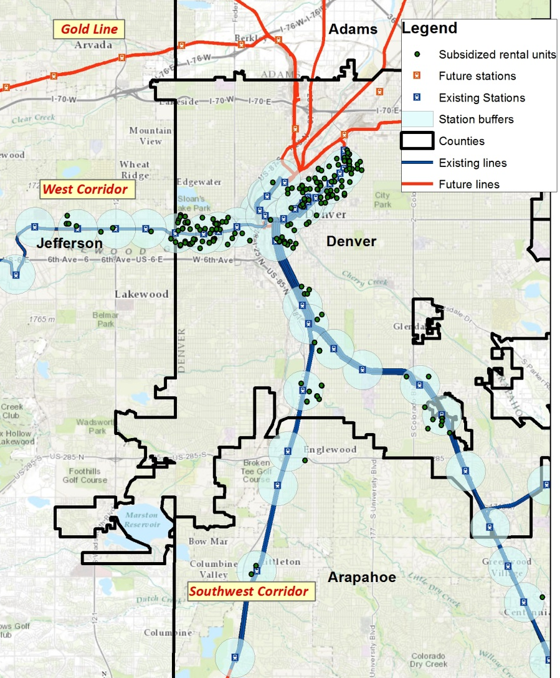
Prior Research
2014 Contract with DRCOG for HUD SCI Grant
Assess current and future stations for:
Affordable housing
Accessibility
Economic Development/Jobs
Overall development
Many of today’s problems were predictable
Most affordable housing was in Denver
Planners complained RTD engineers moved platform locations post TOD design, harming neighborhood access and TOD potential.
No money for sidewalks or other accessibility infrastructure- but lots of money for parking.

Slide 8
Phase I: HUD SCI Grant 2014
In 2014: Most stations were 7 du/acre or less. Goal for 50% of future housing.
local bus
regular transit
high-capacity
transit
frequent high-capacity transit
Transit supportive densities

Slide 9
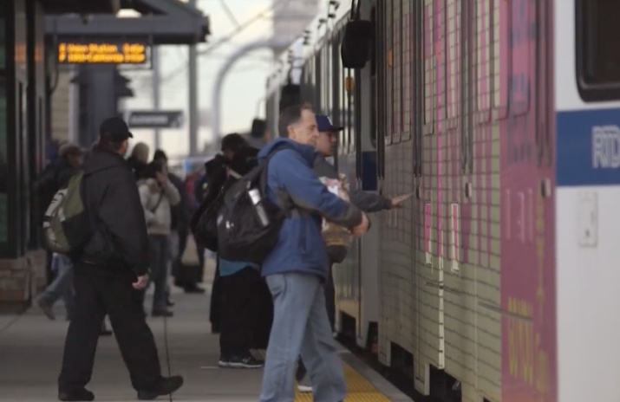
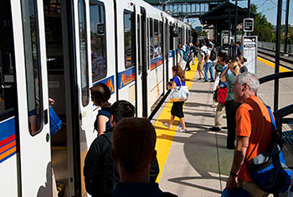
34% of Jobs expected at Existing & Future TOCs by 2022

Slide 10
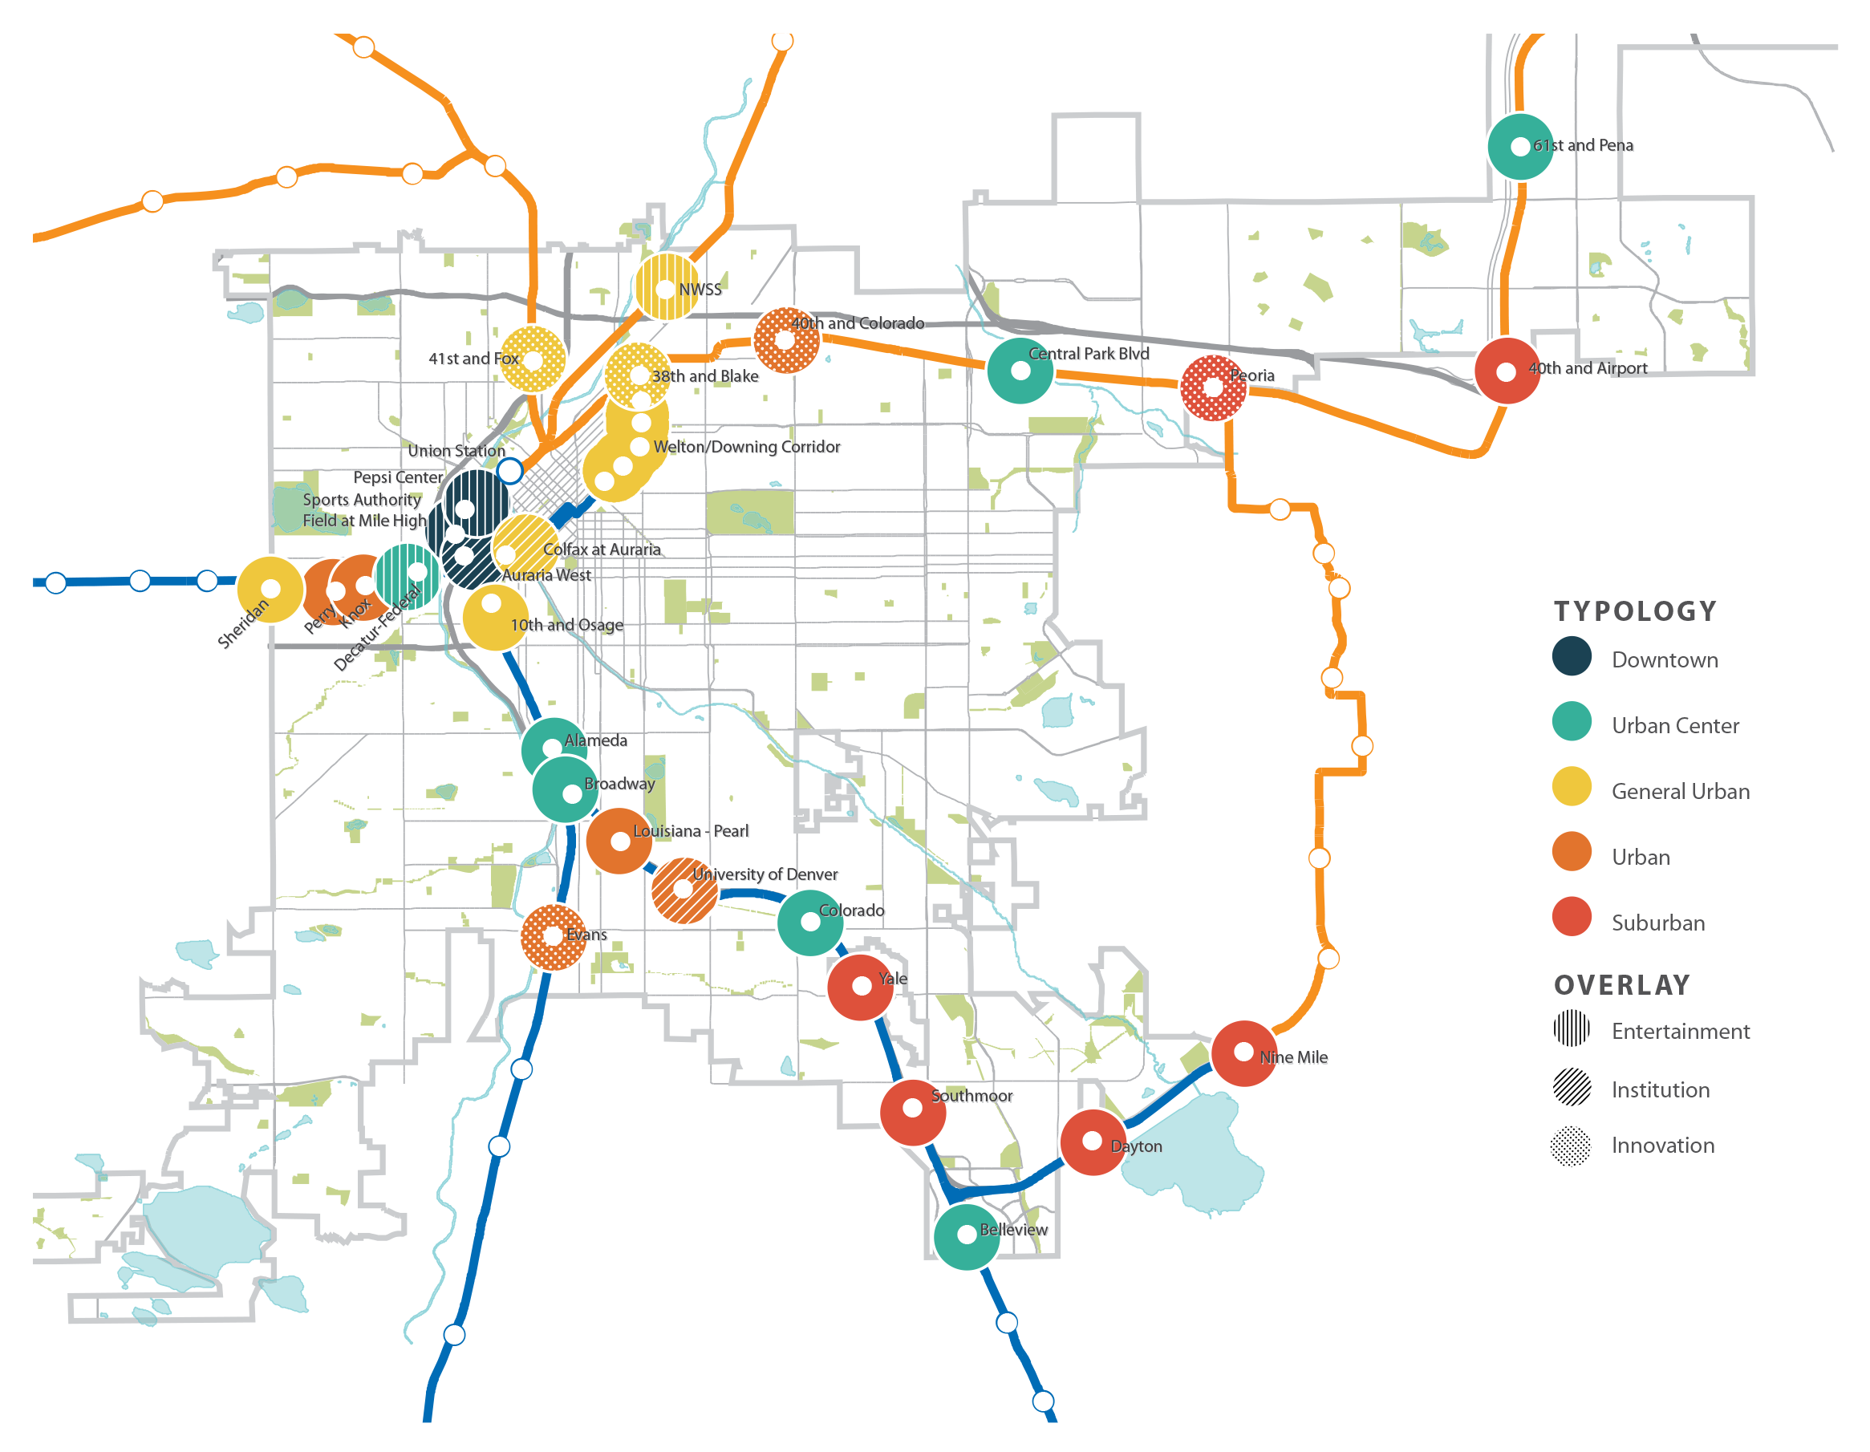
Denver Created a detailed TOD Strategic Framework

Slide 11
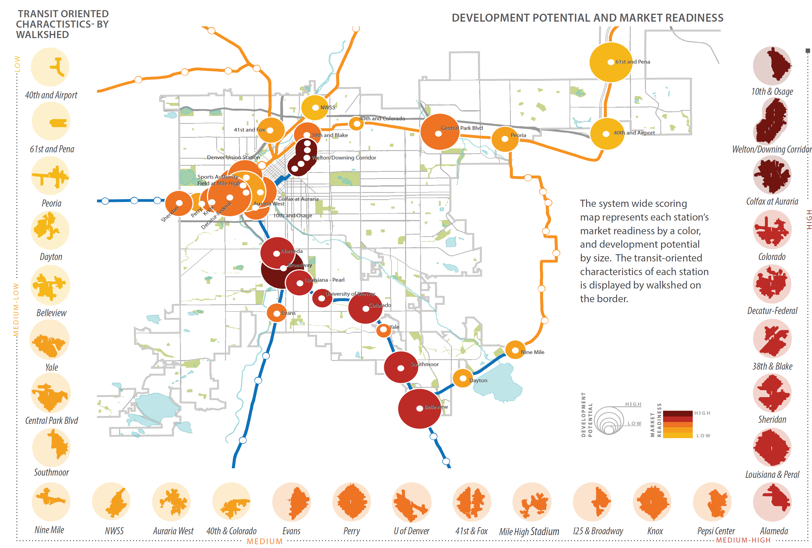
But most walksheds were far less than the ½ mile theorized TOD

Slide 12
Pre and Post Rail Expansion
The good
TOD plans in place
Regional HUD-SCI grant showed promise for collaboration around planning growth
Rail would expand to Adams County and several new jurisdictions.
Although Boulder wouldn’t get rail for decades, a BRT offered a band-aid.
The problematic
Some communities against HUD “Sustainable” Communities Initiative and two planned to vote to downzone from TOD commitments.
Several lines opened 1 – 2 years late with stops and starts and large cost overruns.
  Non-users still question whether rail is reliable based on these rough starts
Rush to build new lines created enormous capital debt with little left for operations.
Expedient alignment reduces TOD potential.

Slide 13
Methods
Quantitative trend data
Interviews in 2014 and 2024 (ongoing)
Land Use Analysis: ongoing
  zoning
  year built, building type, affordability, occupants, vacancies
  TOC commercial uses
Focus Groups for another sales tax for transit on Fall 2026 ballot
Station Site Visits: ongoing
  Sidewalk connectivity
  Wayfinding
  Sense of safety
  Ease of access

Slide 14
Land Use Analysis

Slide 15
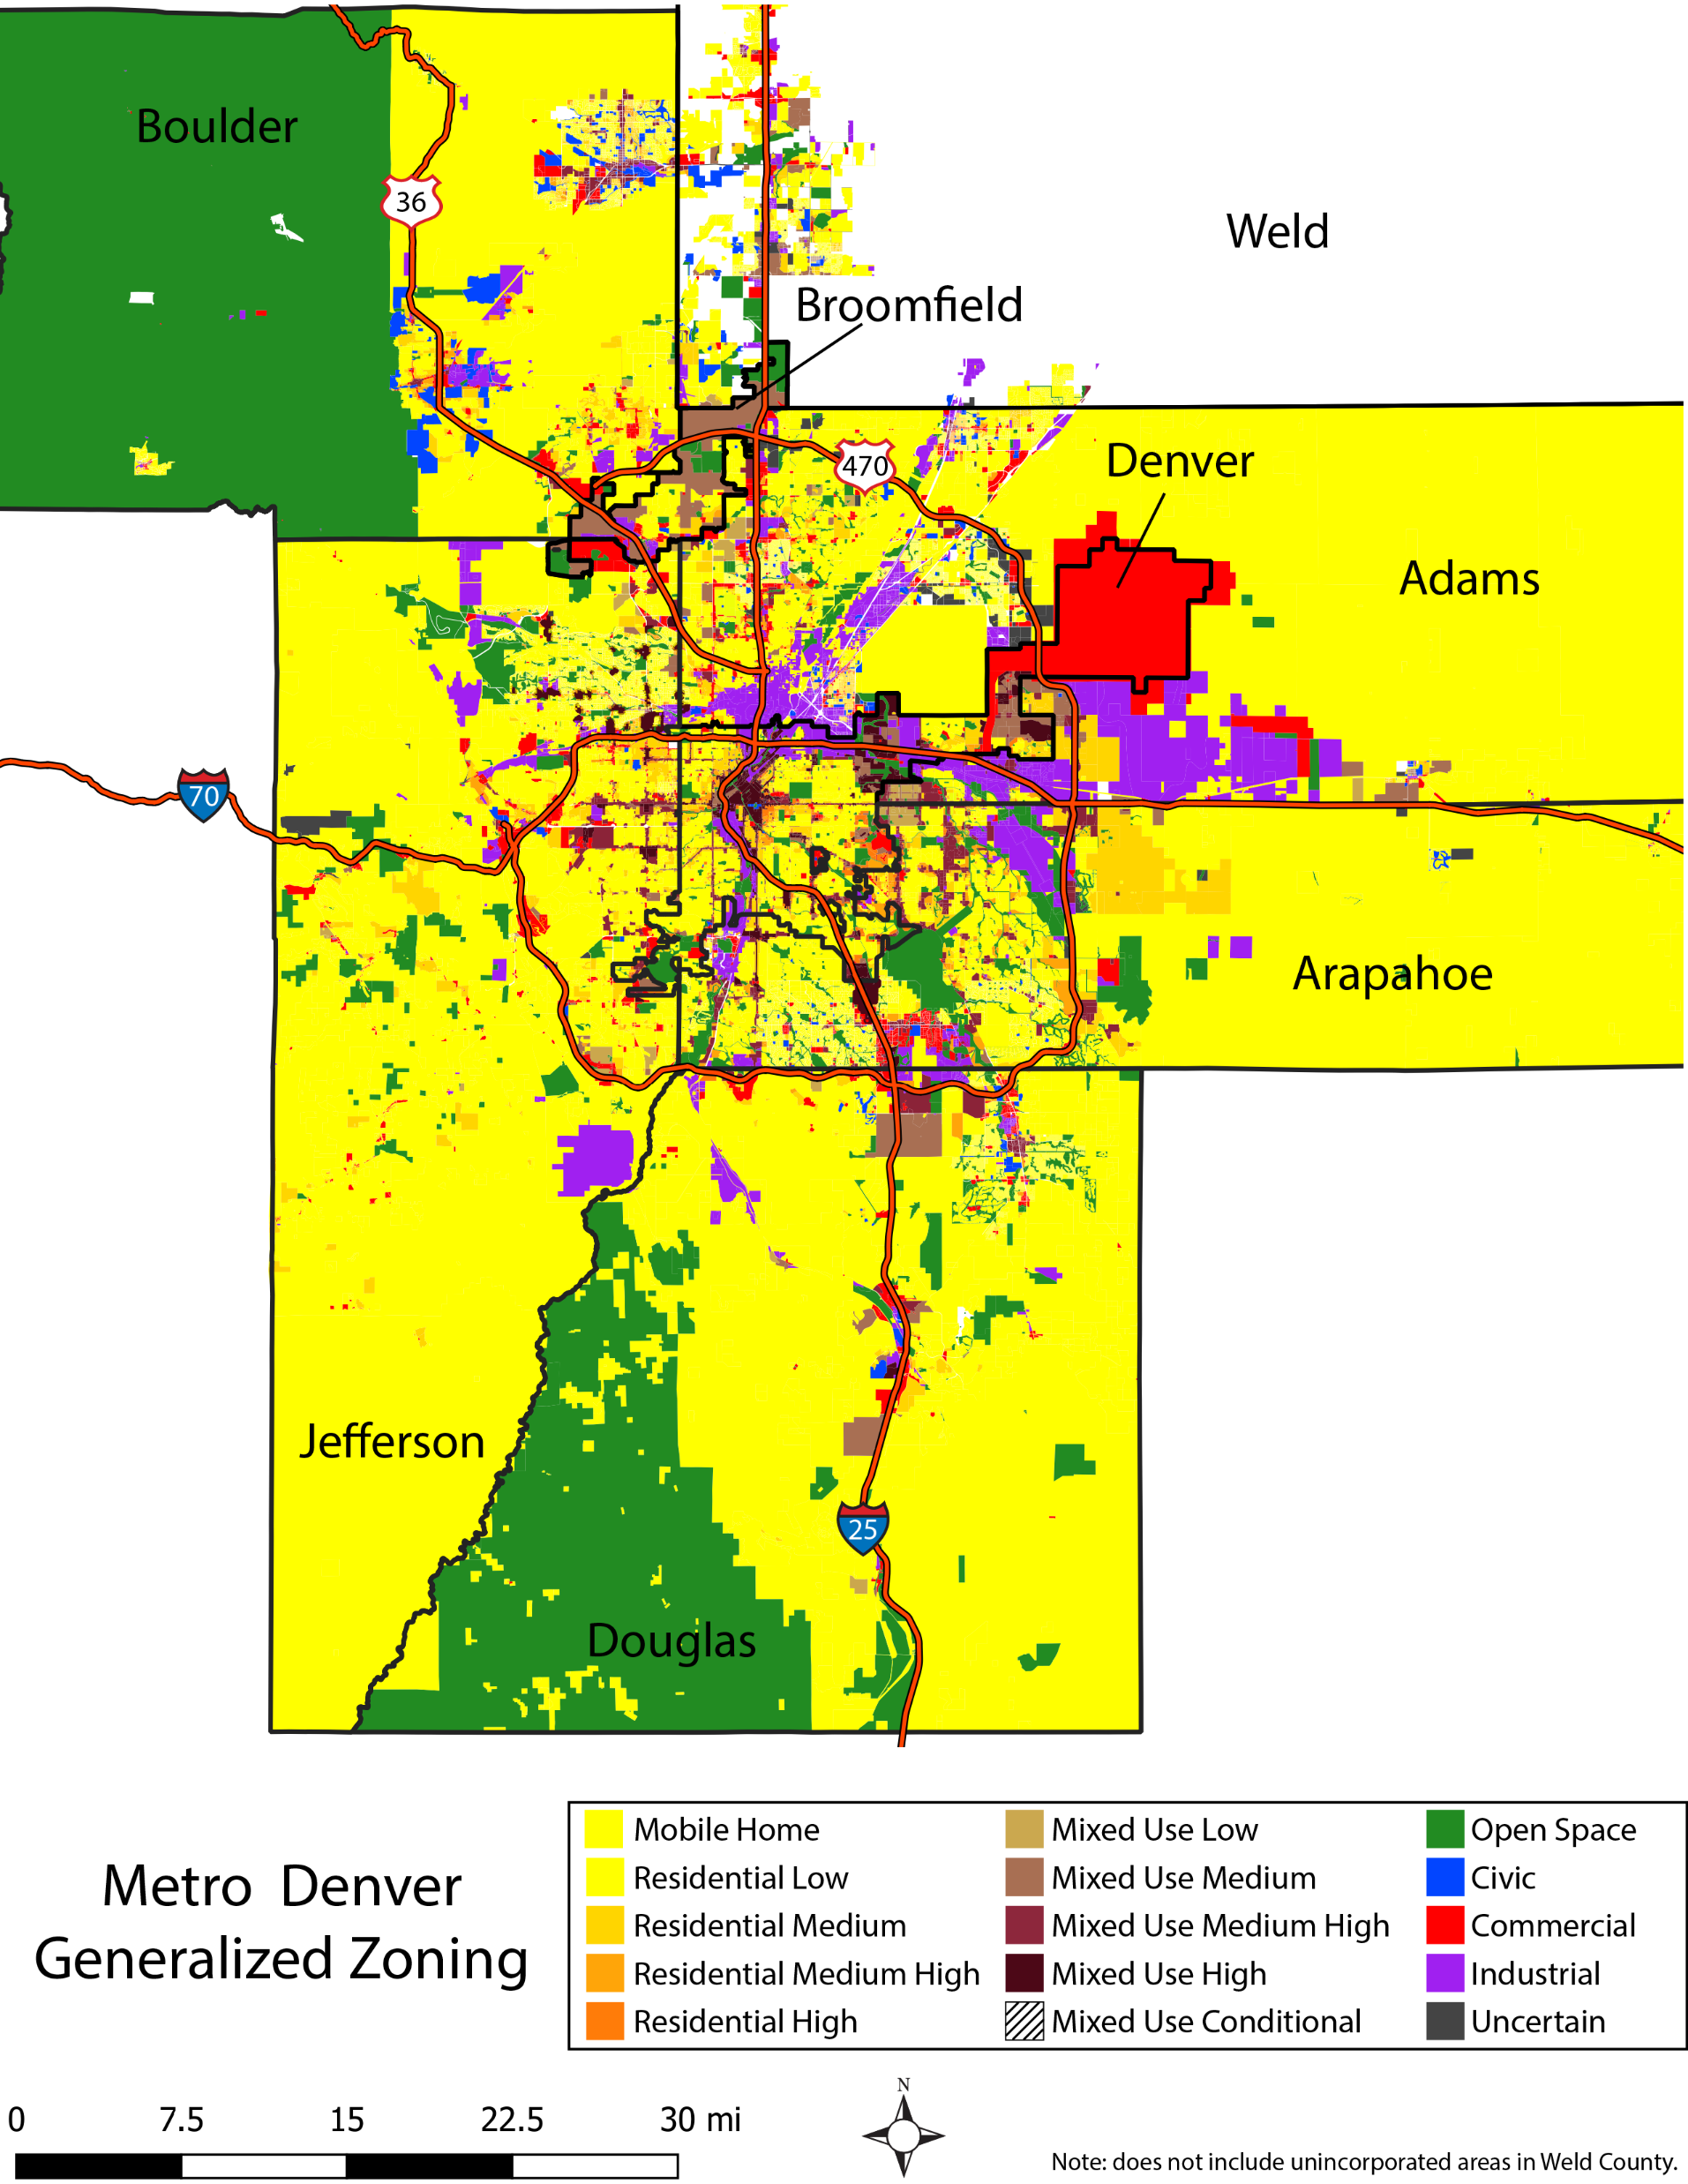
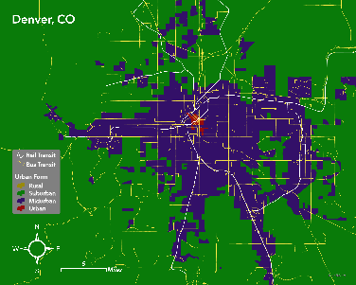
Current Land Use Analysis: Regional View
70% of the region (4,569 sq mi) is zoned SF detached housing
Urban / Midurban / Suburban Density Pattern: Midurban around most rail lines. Most live/work in suburban areas.

Slide 16
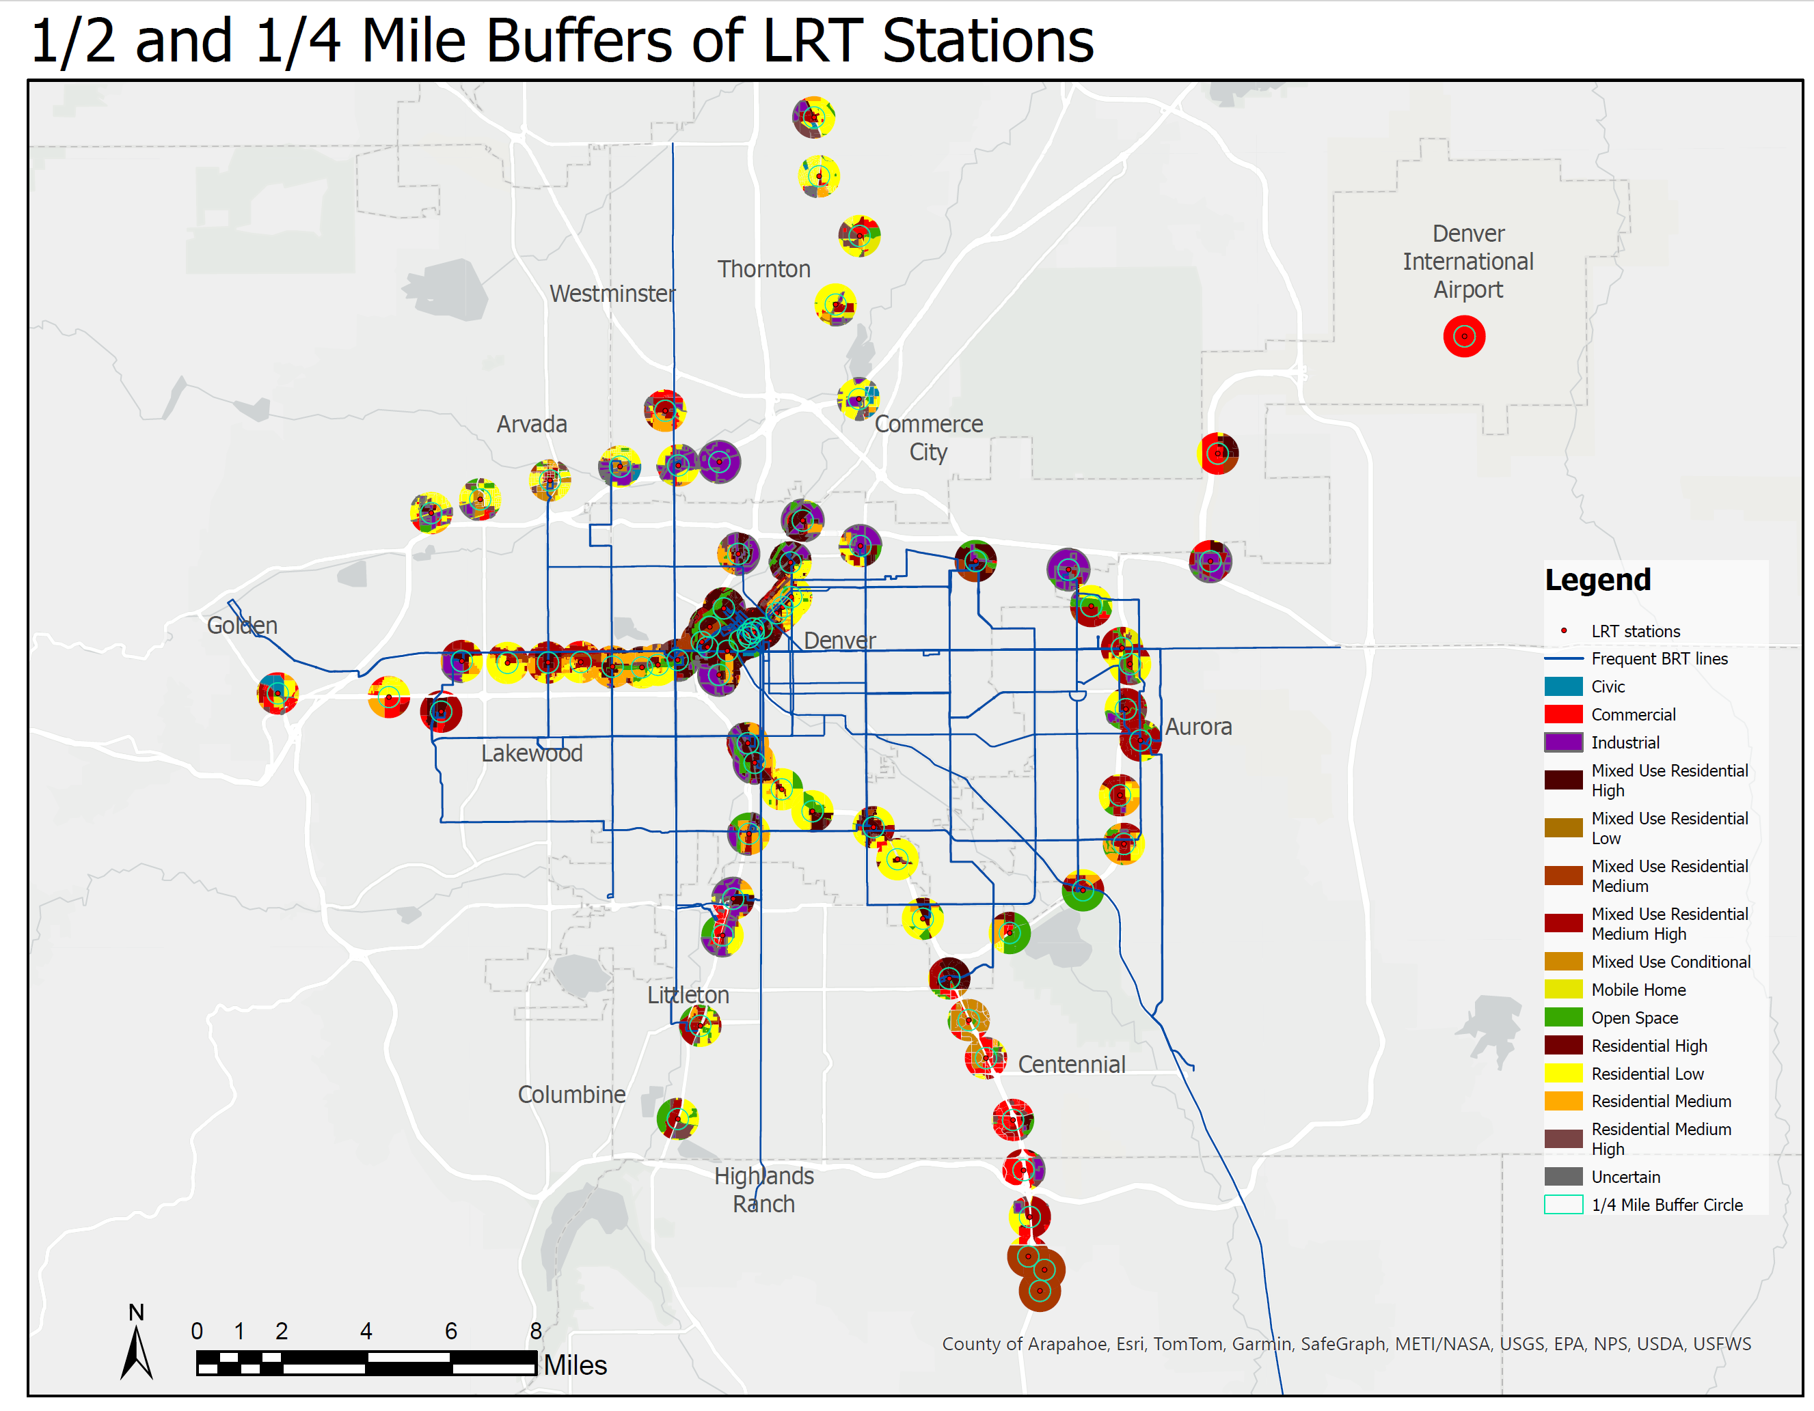
Land Use Analysis: Zoning within TOC areas
Many stations (mostly in Denver) are zoned for mixed-use residential, but it’s not enough.
More than 50% of land zoned low density res. or industrial
Generalized Zoning | % of 1/2 Mile | Cumulative
Mixed Use Res-High | 15.4% | 34%
Mixed Use Res-Med | 10.7%
Mixed Use Res-MedHigh | 3.8%
Residential-High | 0.3%
Residential-Med | 2.3%
Residential-MedHigh | 1.2%
Civic | 0.3%
Commercial | 8.6%
Industrial | 8.6%
Mixed Use-Conditional | 0.3%
Mobile Home | 0.15%
Mixed Use Res-Low | 0.04% | 48%
OpenSpace | 18.9%
Residential-Low | 29.4%
Uncertain | 0.03%
Grand Total | 100% | 82%

Slide 17
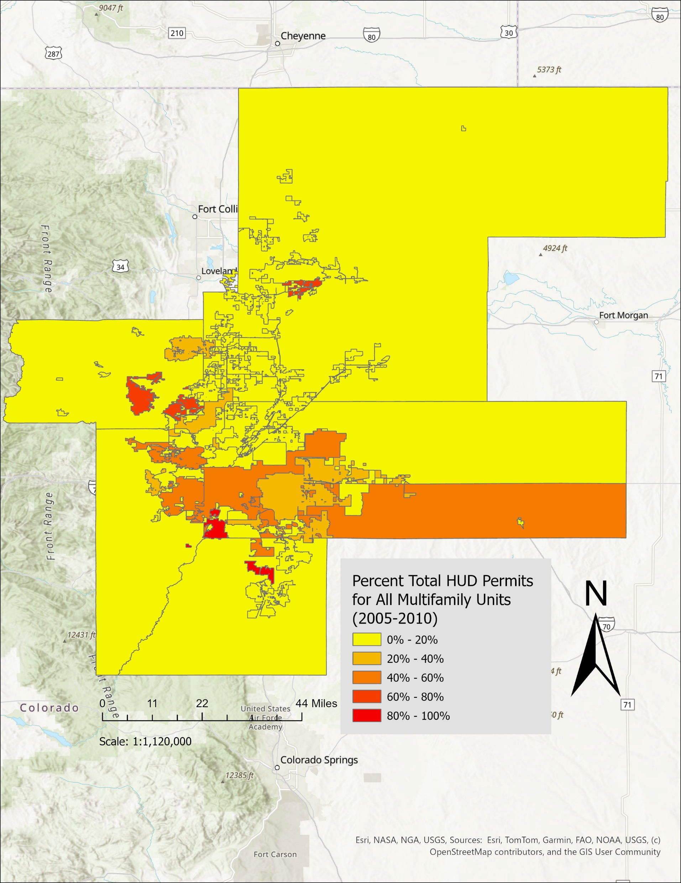
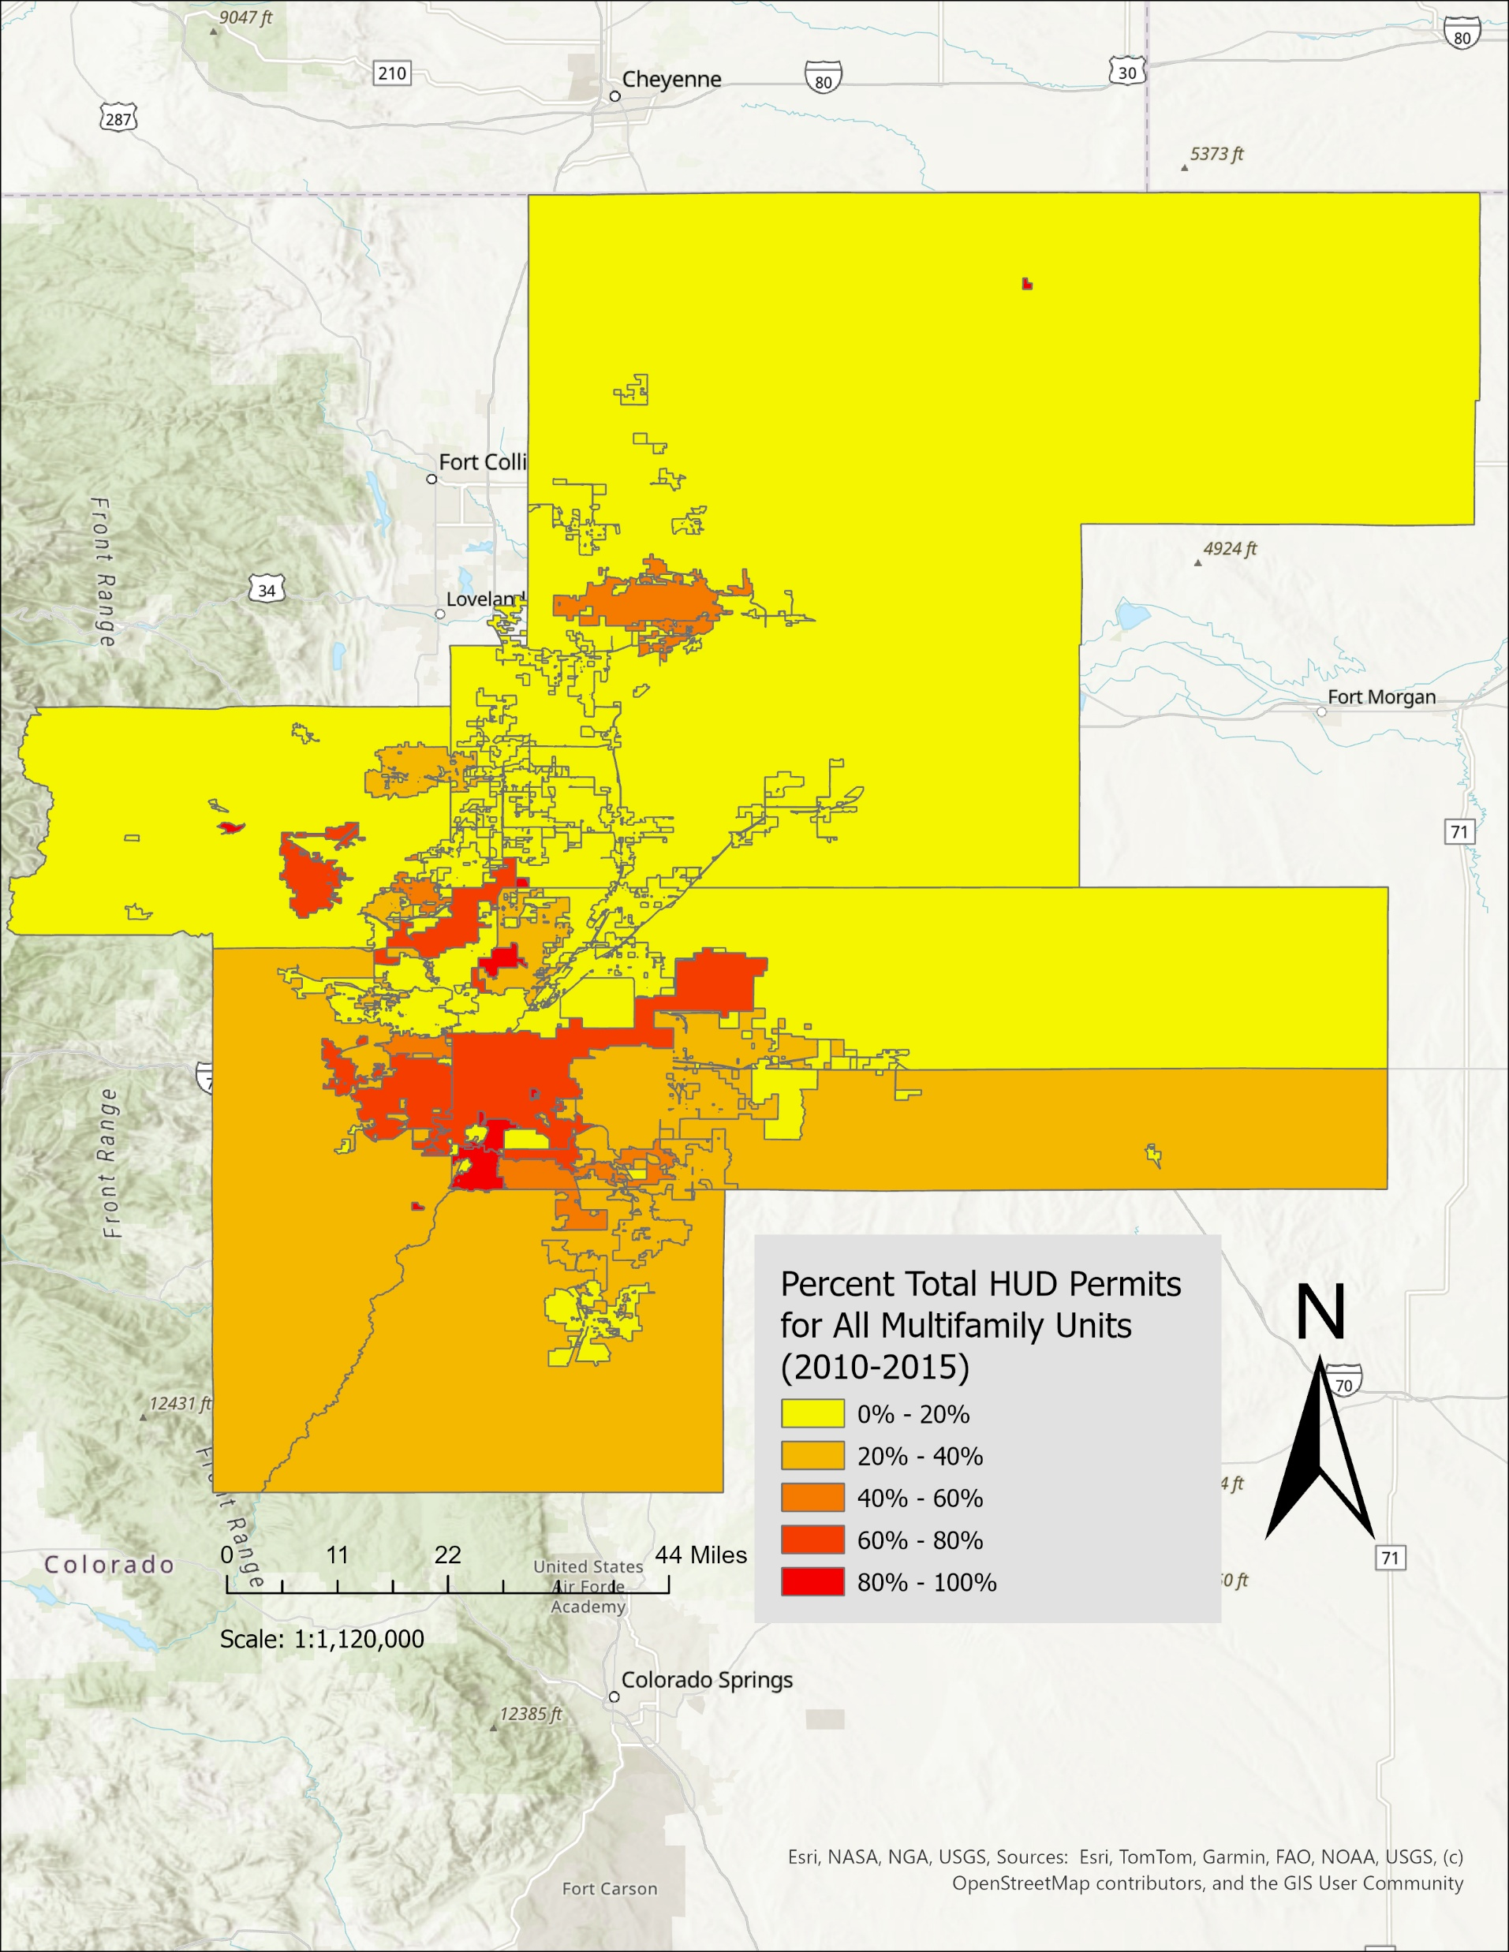
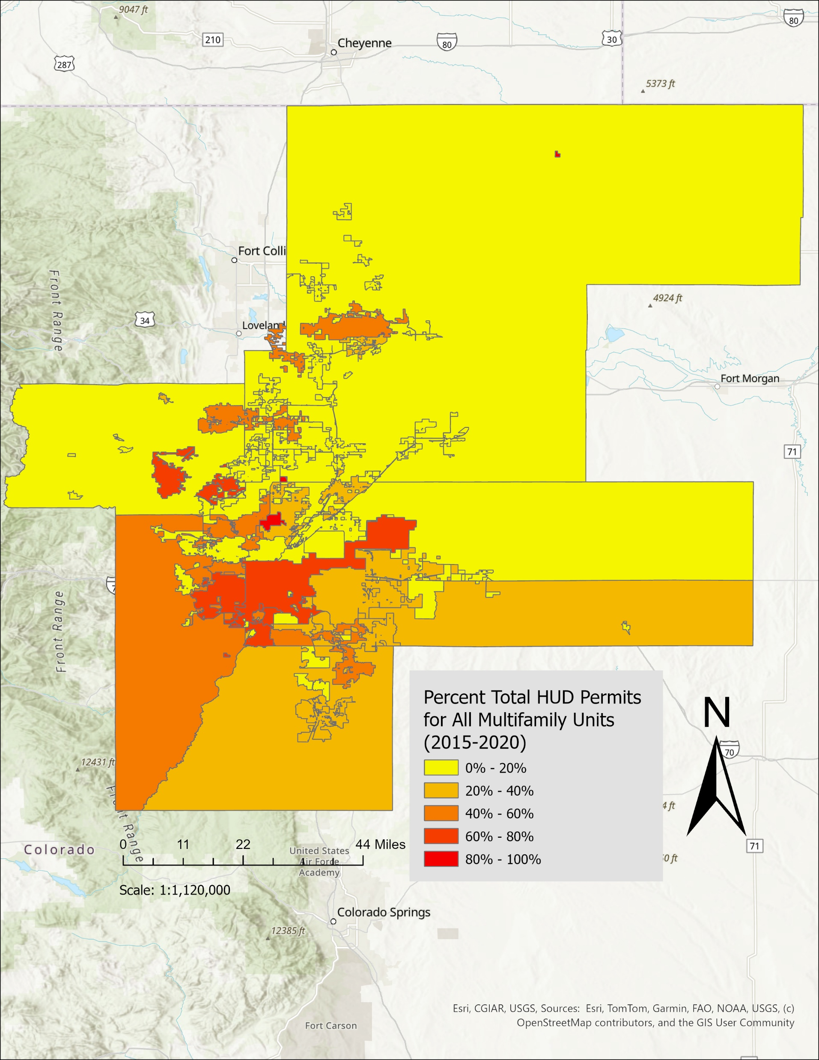
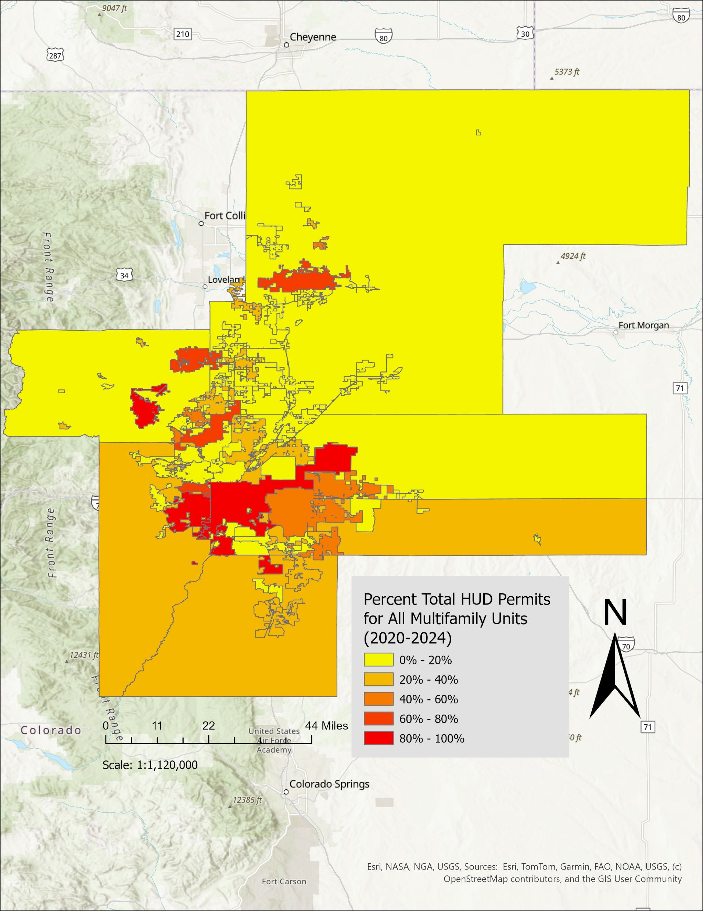
From Zoning to Multi-Family Permits: 2000 - 2024
Housing Unit Permits (HUD, SOCDS):
Increase in denser multifamily units over time, but the quantity remains below the amount needed.
MF Units are not going in many of the most job-rich locations with transit stations

Slide 18
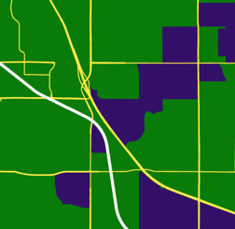
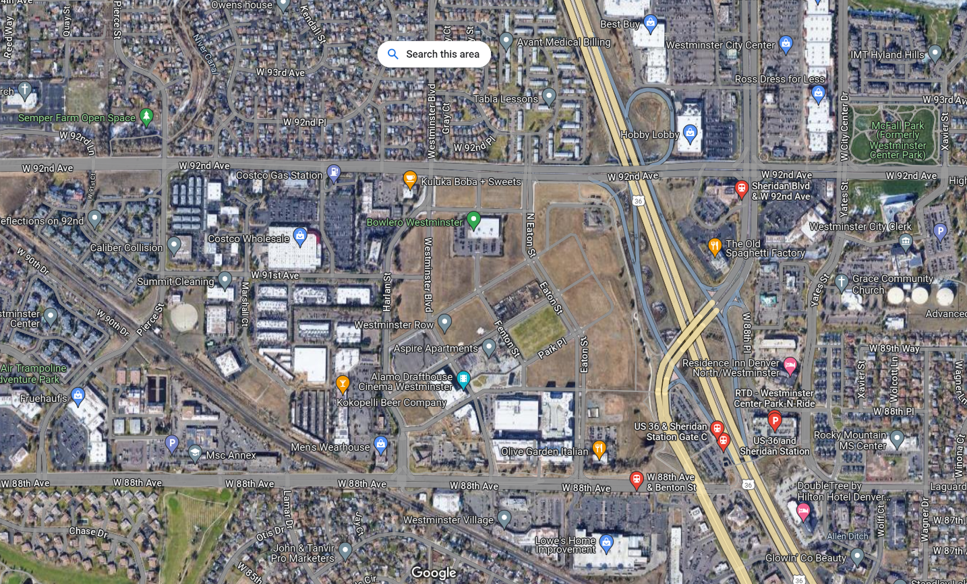
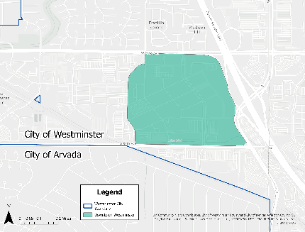
Midurban “Retrofit” Case Study: Westminster’s new Downtown near rail
Former mall “gray-field”
Near rail and BRT
Post-war suburb
City-led redevelopment: $74M, staff, and land
Mixed-use, density, and walkability goals
Central Park
20-year timeline

Slide 19
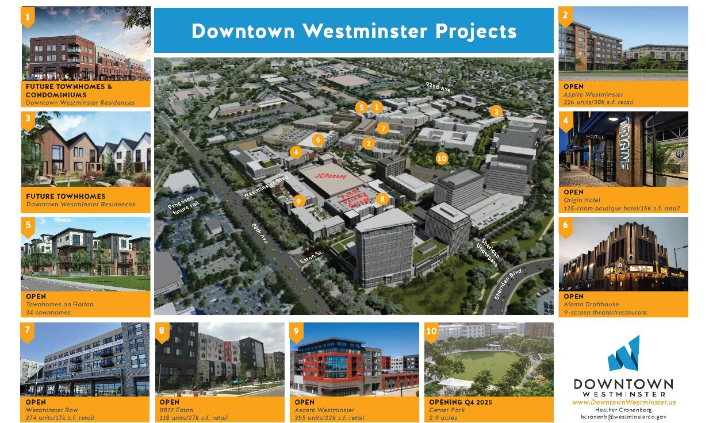
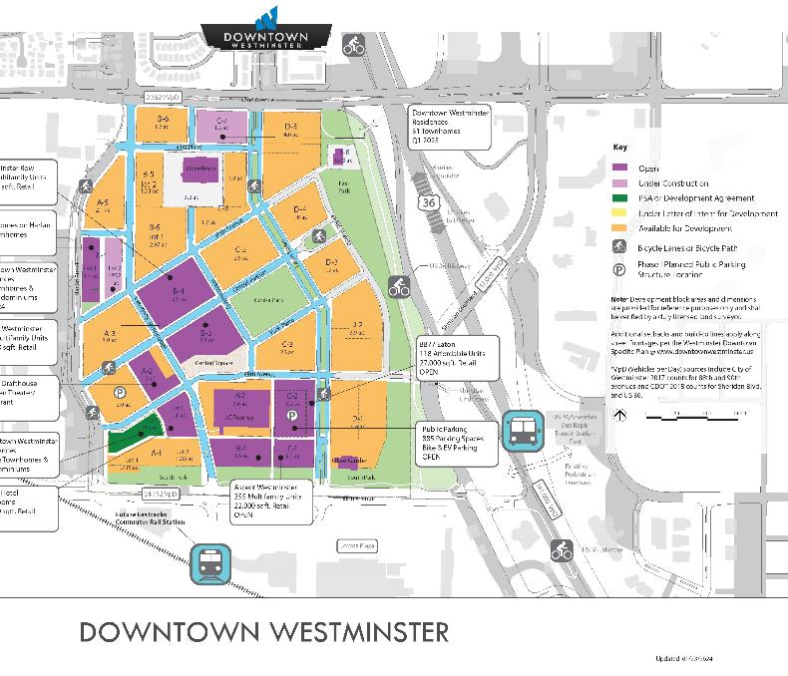
The Vision
Strengths and areas for improvement
Density near transit, greater densities than elsewhere in Westminster and Denver suburbs, mix of housing types
A central park and parkways for convening, community building, mental health/nature access, sense of place
Street connectivity, yet fairly large blocks may reduce walkability and small-scale local businesses
Other suburban characteristics, e.g., high parking ratios, that encourage driving.

Slide 20
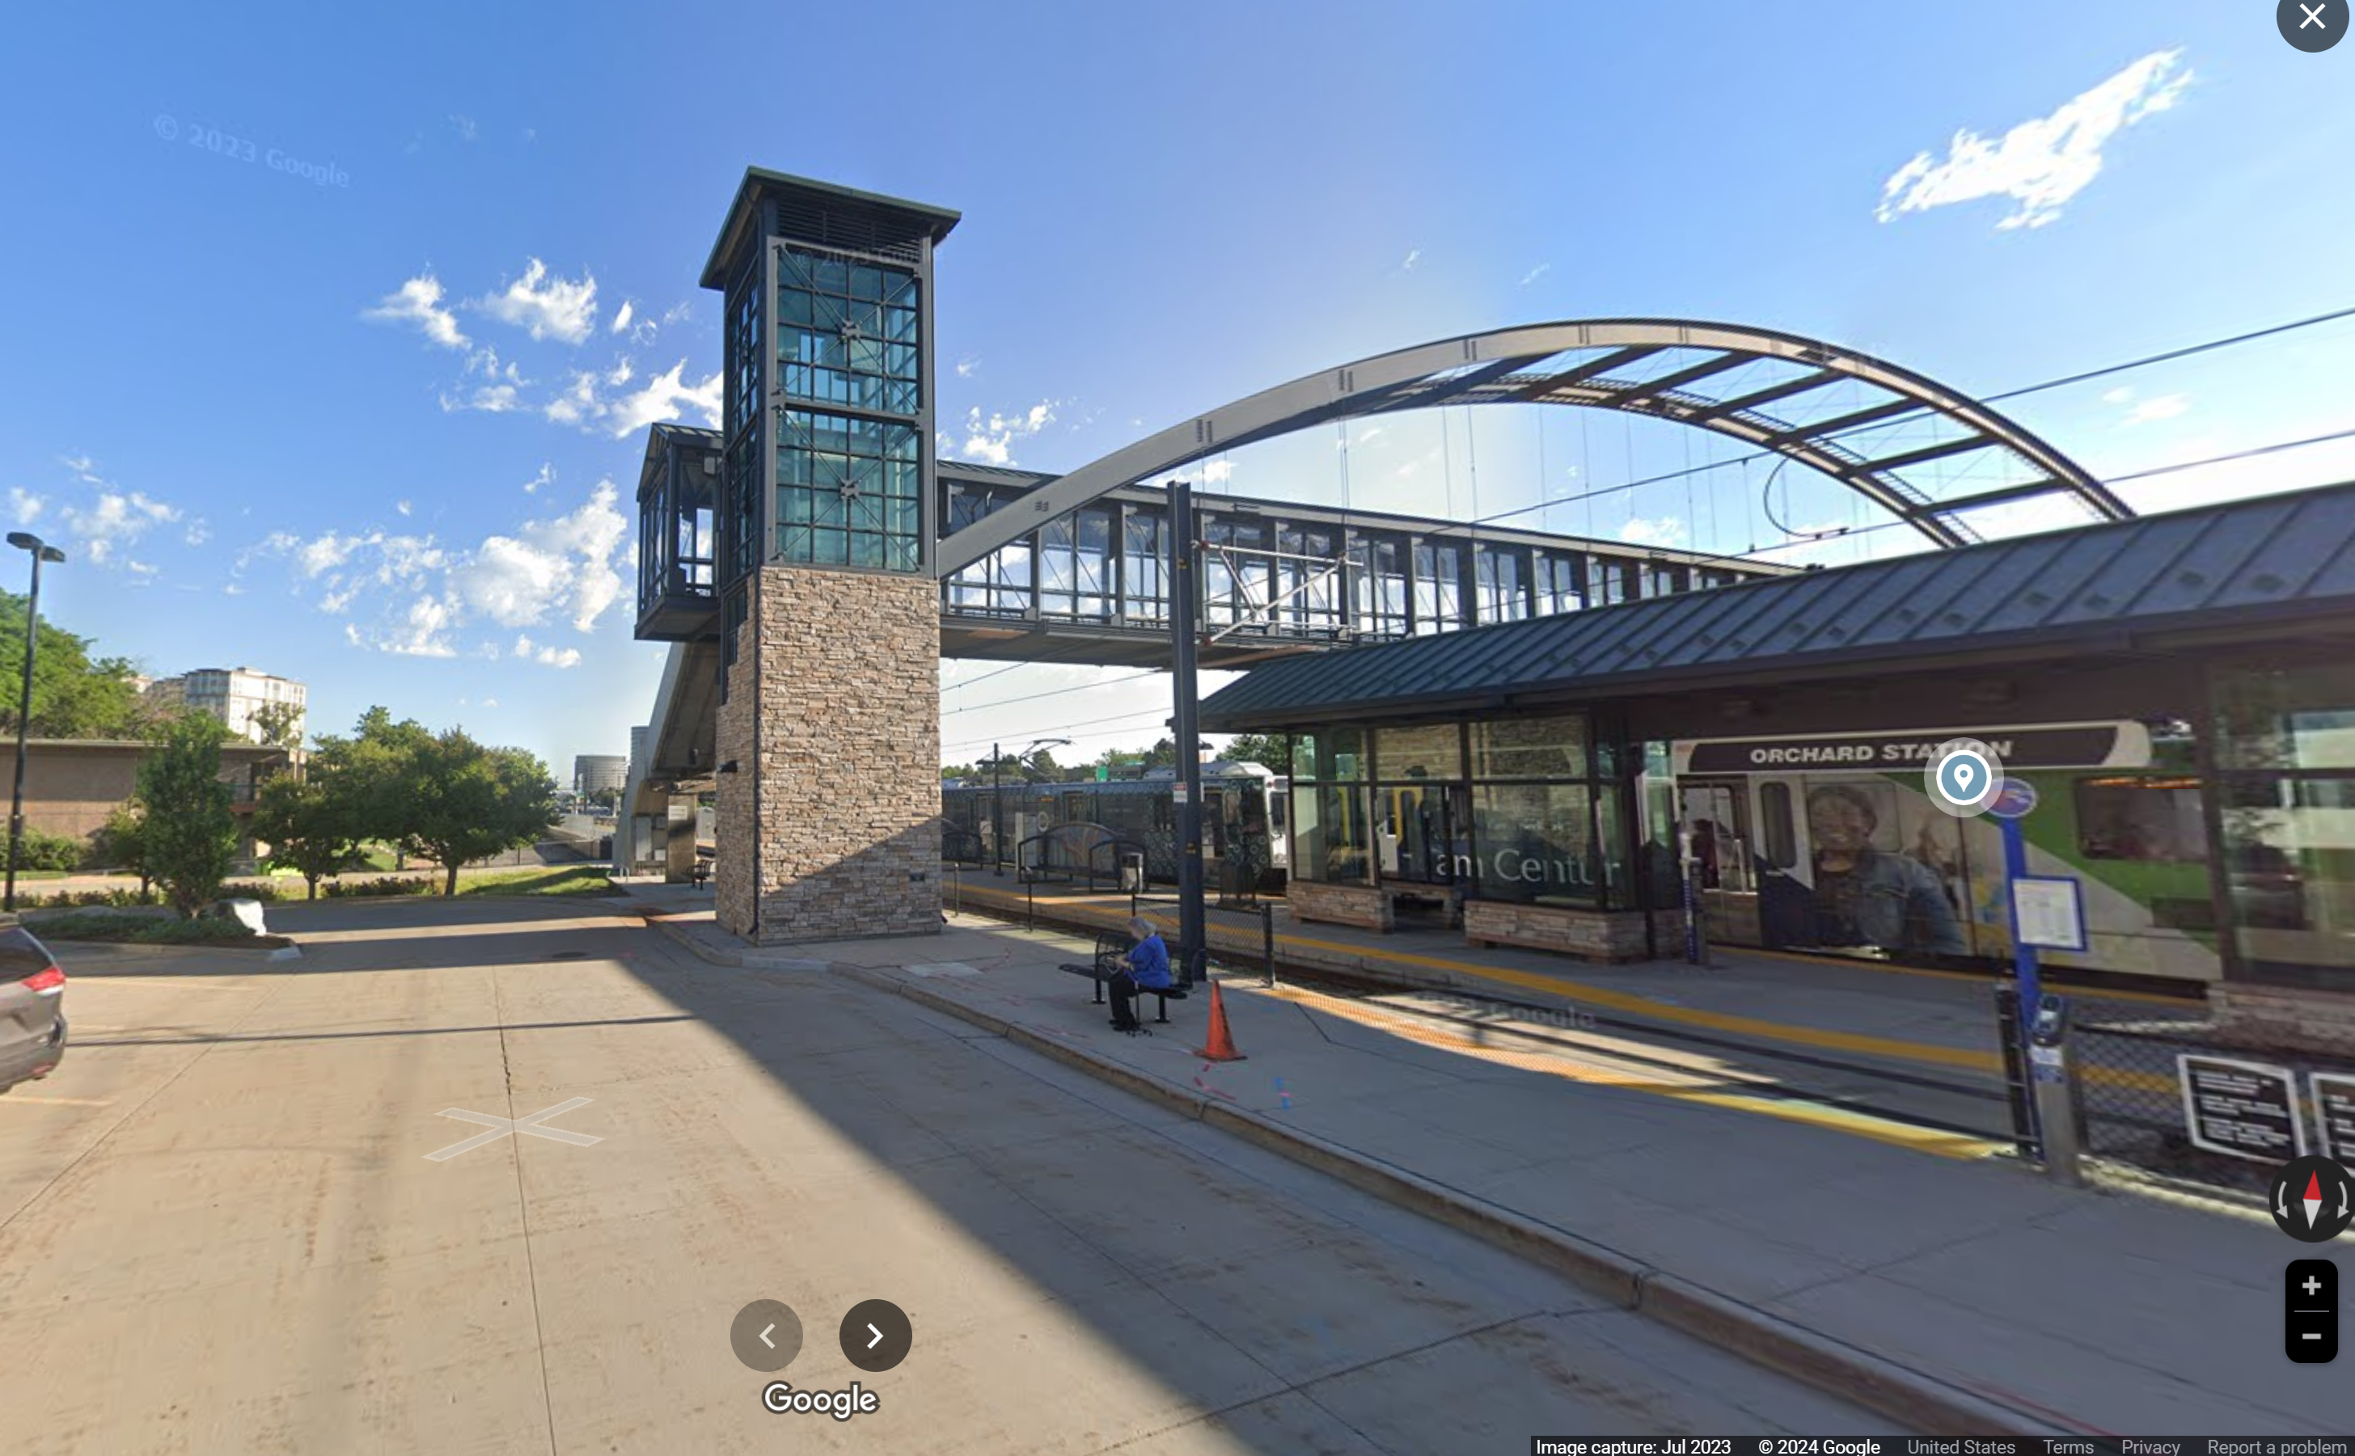
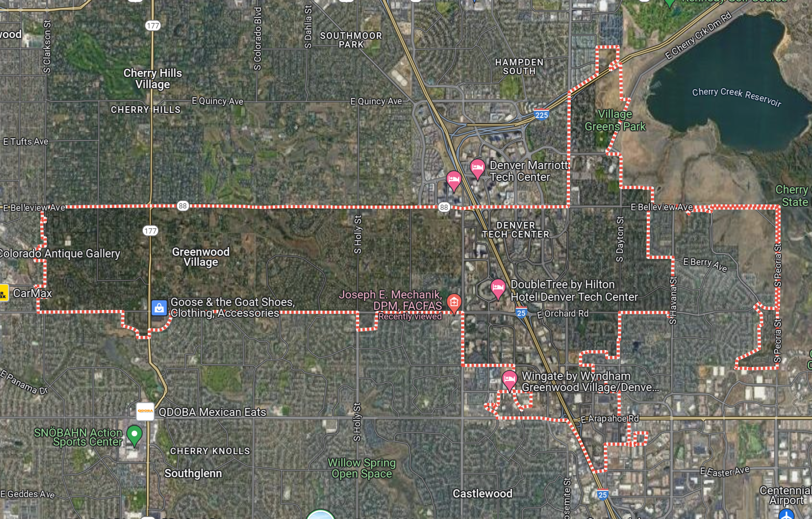
Opposition: Orchard Station in Greenwood Village

Slide 21
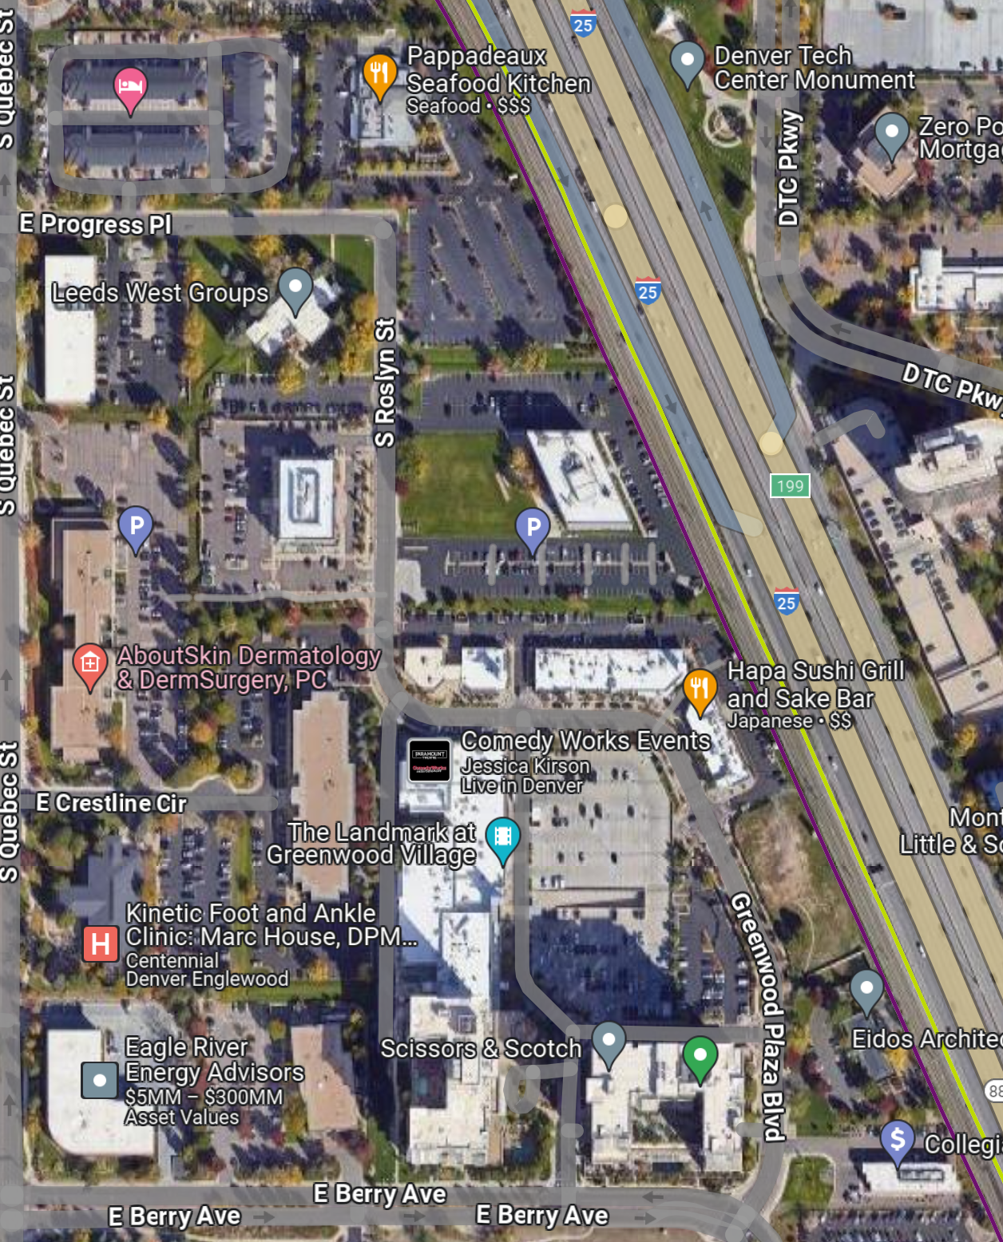
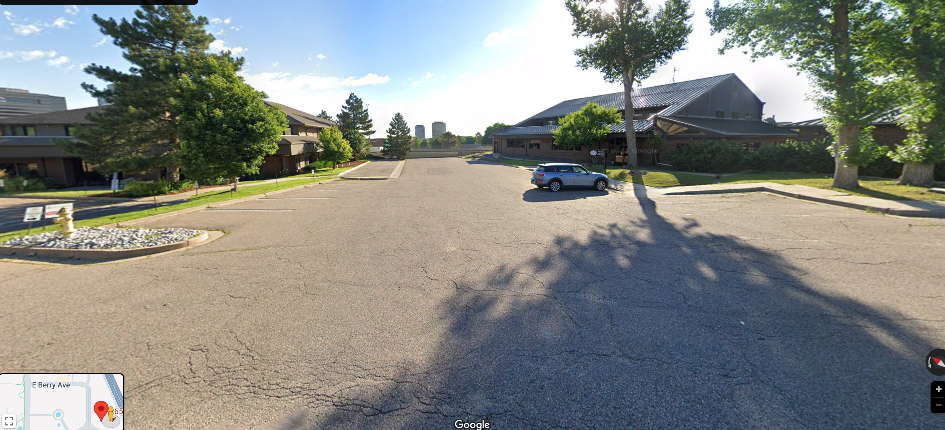
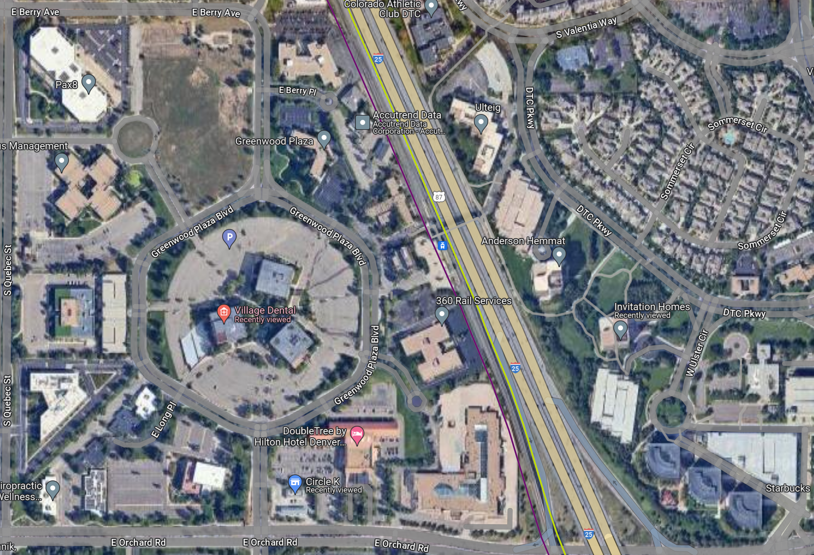
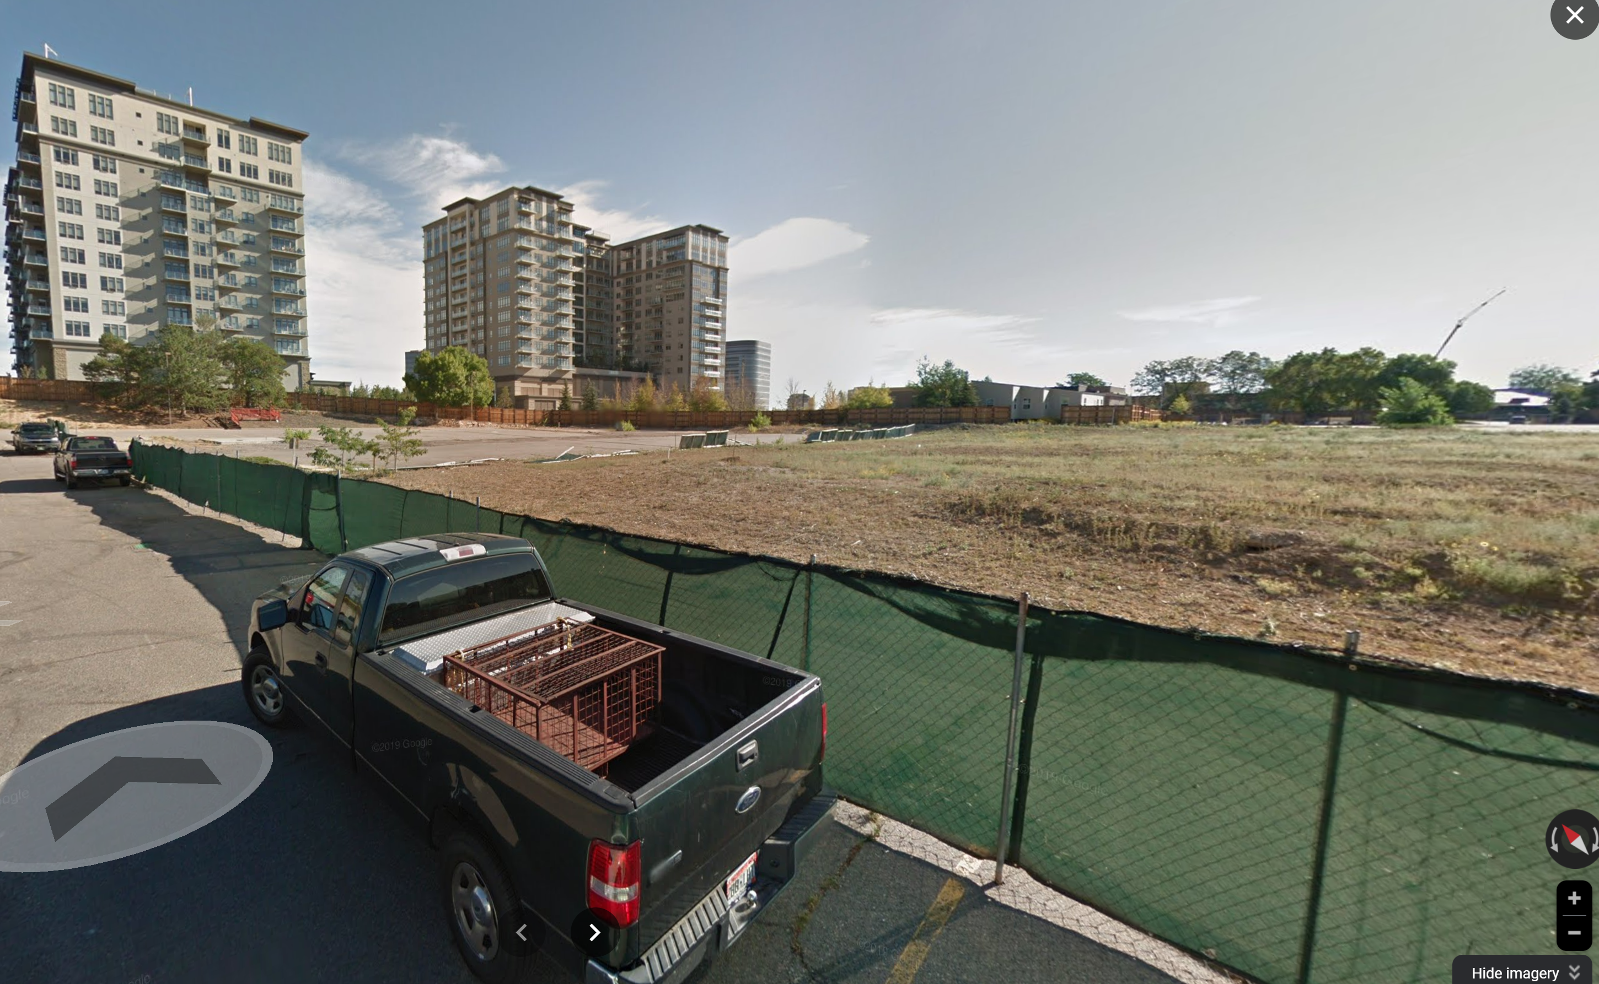
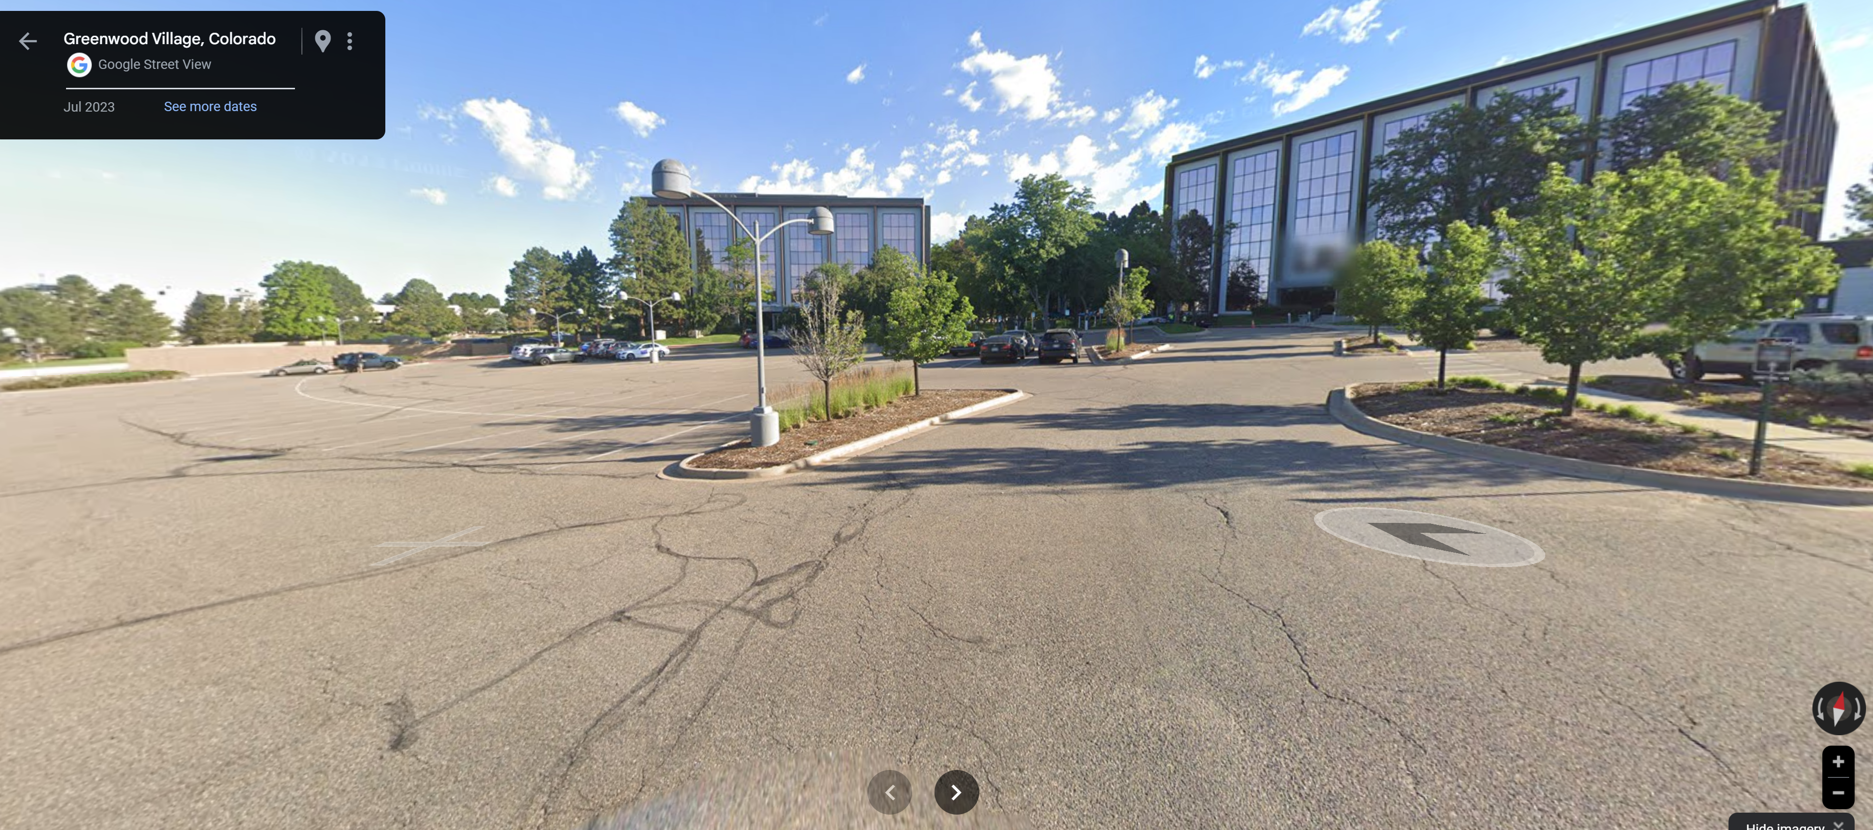
320 acres of office buildings, includes 150 acres of parking and grass
Greenwood Village downzoned near transit and is suing the state for current TOC Bill.
North of Berry
North of Berry

Slide 22
Jobs

Slide 23
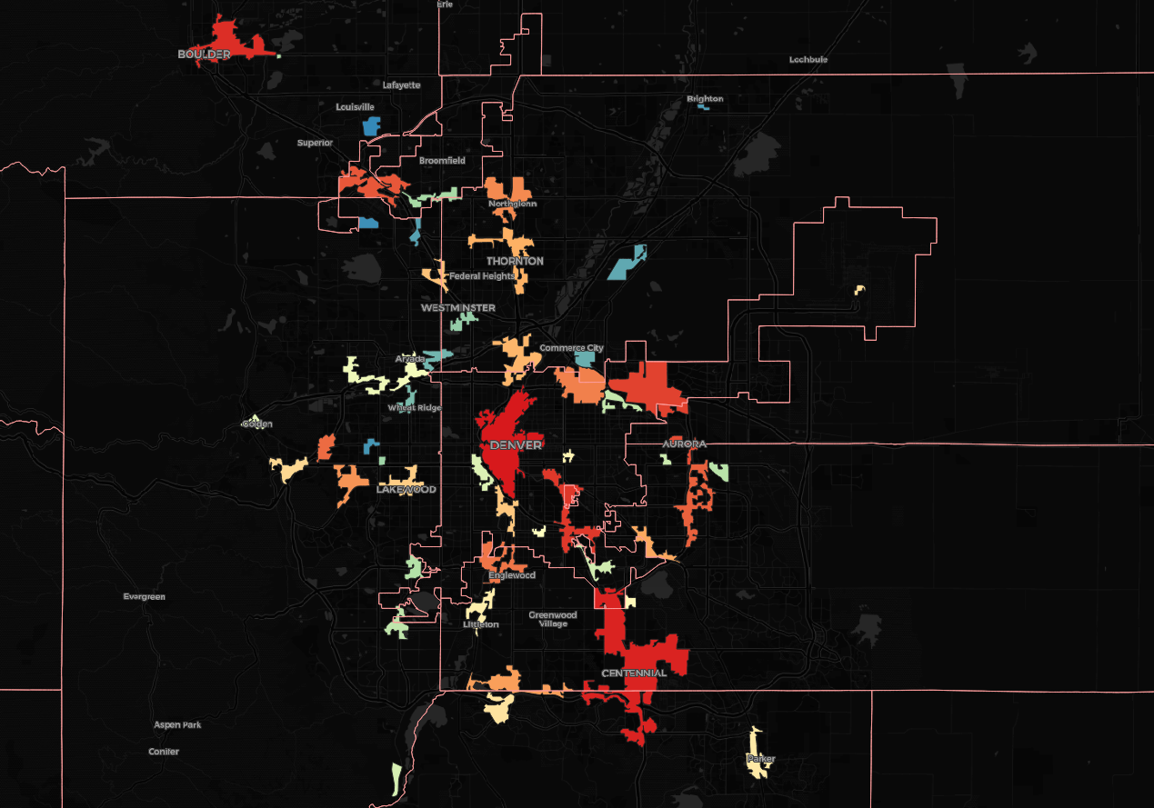
PRIMARY CENTERS
60% of Jobs in 58 “primary centers”
Roughly follow the train lines
Source: Authors analysis using Census LODES

Slide 24
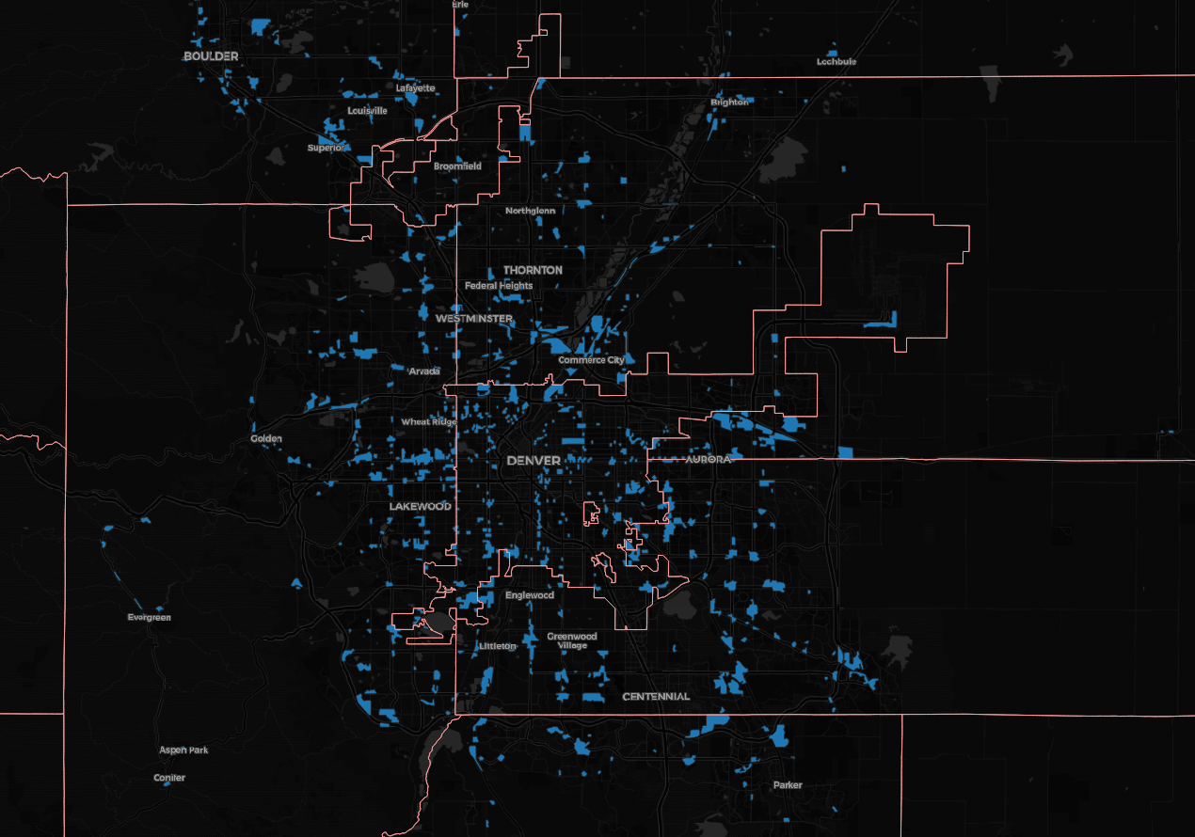
SECONDARY CENTERS
20% of Jobs in “secondary centers”.
The remaining 20% are scattered.
Source: Authors analysis using Census LODES

Slide 25
Lower wage jobs are significantly more prevalent in secondary and uncentered locations with poor transit options.
Source: Authors analysis using Census LODES

Slide 26
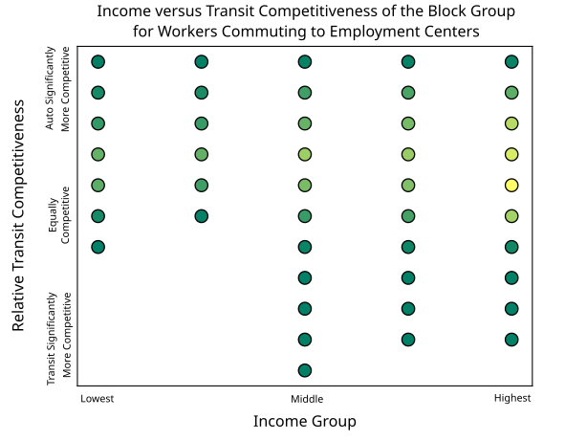
Transit is not time competitive for Lowest Incomes.
Significant mismatch: no block groups with a low-income average, have transit options that offer competitive commute times to their work destinatons

Slide 27
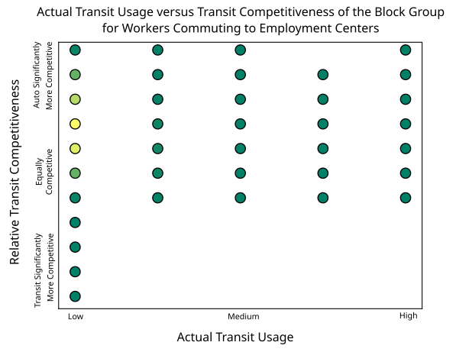
areas with high transit competitiveness (higher income block groups) lack higher actual transit usage
**note – since the travel times analysis does not considerer traffic, this may lose areas where light rail becomes more competitive than driving during rush hour

Slide 28
Beyond Land Uses

Slide 29
Affirmations from Site Visits
Wayfinding
Wayfinding is missing or lacking at all stations
People sitting in a park two blocks from a station didn’t know the rail was nearby.
Access
Stations are lacking connected sidewalks, adequate bike facilities, and bike lanes leading to station.
Many stations are adjacent to interstates, large arterials, and RR tracks
Excessive parking, surface and garage, is a barrier to pedestrian access.

Slide 30
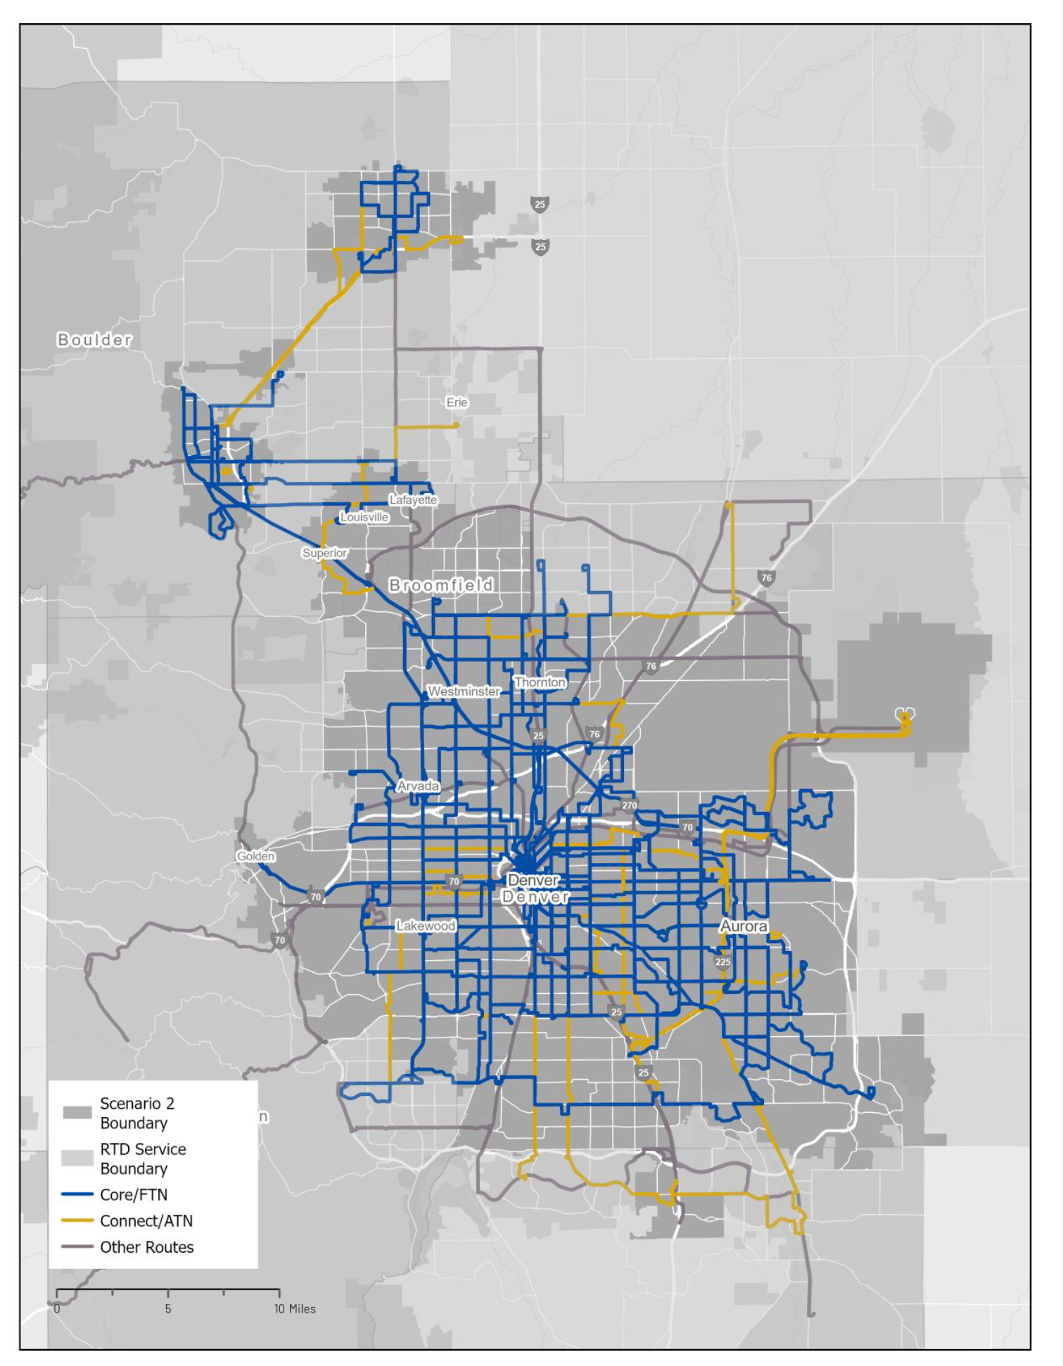











Plan to increase $ for better transit
Focus Groups for Alliance to Transform Transportation
Awareness of & usefulness of transit
Participants who don’t use the transit hear it’s unreliable, unsafe, and expensive.
Most don’t know when and where it goes.
Others know it doesn’t go where they need it to go.
Distrust RTD; but also distrust local government.
Safety
One of the biggest concerns for all participants, but it’s not part of the Alliance’s plan.

Slide 31
So what explains the decline?

Slide 32
T/LU, Urban Design, or Transit Operations?
TOC Principles: Land Use and Design
Operations: Institutional and financial
Densities are still too low near transit
Very little walkable commercial
Almost no wayfinding:
  Who should do it? City ROW, RTD’s system.
Missing sidewalk and bike infrastructure
Hardened infrastructure eliminates development potential
Jobs/housing spatial mismatch
High capital debt left little operations funding: lines are shut down for months at a time
Poor reliability
Increasingly low frequencies
Lack of transit workers
Safety and comfort are real and perceived issues. RTD needs partners.
RTD “likes to sit back” and not speak up for itself.
If transit doesn’t take people where they need to go, when they need to go, and safely, are TOCs enough?
Will time and new state TOC mandates help?

