Slide 1

The Sustainable Neighborhoods Network:
A City-citizen Partnership to Promote More Sustainable Behaviors
Carrie Makarewicz, Ph.D.
Department of Urban & Regional Planning

Slide 2
outline
Accomplishments in our 3 year period
Why your program is of interest to scholars
  Literature: co-opting; janus-faced; monitoring and evaluation; politicization; individuation of climate change; social marketing
  How we studied it
Many pitfalls and problems with civic participation programs “beyond-the-state” and “individuation”
The innovative SNN model avoids them and potential to be a model
  Reasons why
That’s why you have had these successes:
  Quotes and things
Looking forward:
  Keep doing: building community (beyond private and public spheres)
    Allow spaces for activism outside SNN so SNN isn’t seen as a tool to squash activism
  Watch out for, or change (is it gendered? See harwood’s Spain quote)
    Ensure everyone feels comfortable seeking assistance (Harwood)
    Don’t make it seem like “taking care of the neighborhood” is like “taking care of the home” – it lessens the power of women and the actions they’re doing

Slide 3
A snapshot of your accomplishments

Slide 4
Literature context
‘technologies of citizenship’, which are defined as the multiple techniques of self-esteem, of empowerment and of consultation and negotiation that are used in activities as diverse as community development, social and environmental impact assessment, health promotion campaigns, teaching at all levels, community policing, the combating

Slide 5
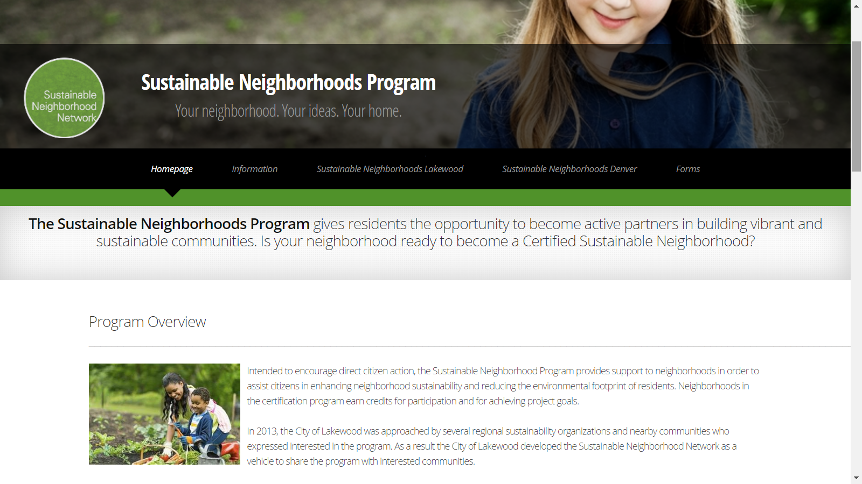
Started by Lakewood Sustainability Division Manager in 2012
Intended to encourage direct citizen action, the Sustainable Neighborhood Program provides support to neighborhoods in order to assist citizens in enhancing neighborhood sustainability and reducing the environmental footprint of residents. Neighborhoods in the certification program earn credits for participation and for achieving project goals.

Slide 6
How it Works
Benefits & Recognition
Neighborhoods use guidance from city/county staff to organize workshops, projects, and events that enhance the livability of their neighborhood and reduce resident’s ecological footprint.
Neighborhoods earn credits (points) from the city/county based on participation and project accomplishments.
Yearly Designations: “Participating” or “Outstanding receive recognition from elected officials and custom neighborhood signage.
5 Goal Areas: Air, Land, Energy, Water, People

Slide 7
Sample Projects in the 5 Goal Areas
Bike to Work Day
Sidewalk assessments
Carbon footprint challenges
Fireplace replacement
Home energy & water audits
Solar Fair
Low water landscaping workshops
Vehicle maintenance
Stream bank projects
Fertilizer reduction campaign
Noxious weed removal
Compost & recycling sign up
Bee-safe campaigns
Community /school gardens
Helping hands networks
Neighborhood historic tour
Local lunch club
Health & Wellness promotion

Slide 8
Program Resources
Lakewood
Denver
Sustainability Division
Funding source: Division’s administrative budget, until 2017
Staffing
  2013-2016 Intermittent 15 hr/week interns 2013-2016
  2017: ¾ FTE + 15 hr/week assistant
  Division manager’s spare time
Other funding
  Newsletter, Mailings, Flyers
  Neighborhood launches & certfications
  Small items, e.g. water at earth day
Department of Environmental Health
Funding source: landfill proceeds
Staffing:
  1.5 FTEs approved every 2 years
Other funding
  Neighborhood launches
  Newsletters, mailings, flyers
  2016: $10,000 for small grants to neighborhoods
  Future goal: $5, 000 for each neighborhood

Slide 9
Program Evolution in Lakewood & Denver

Slide 10
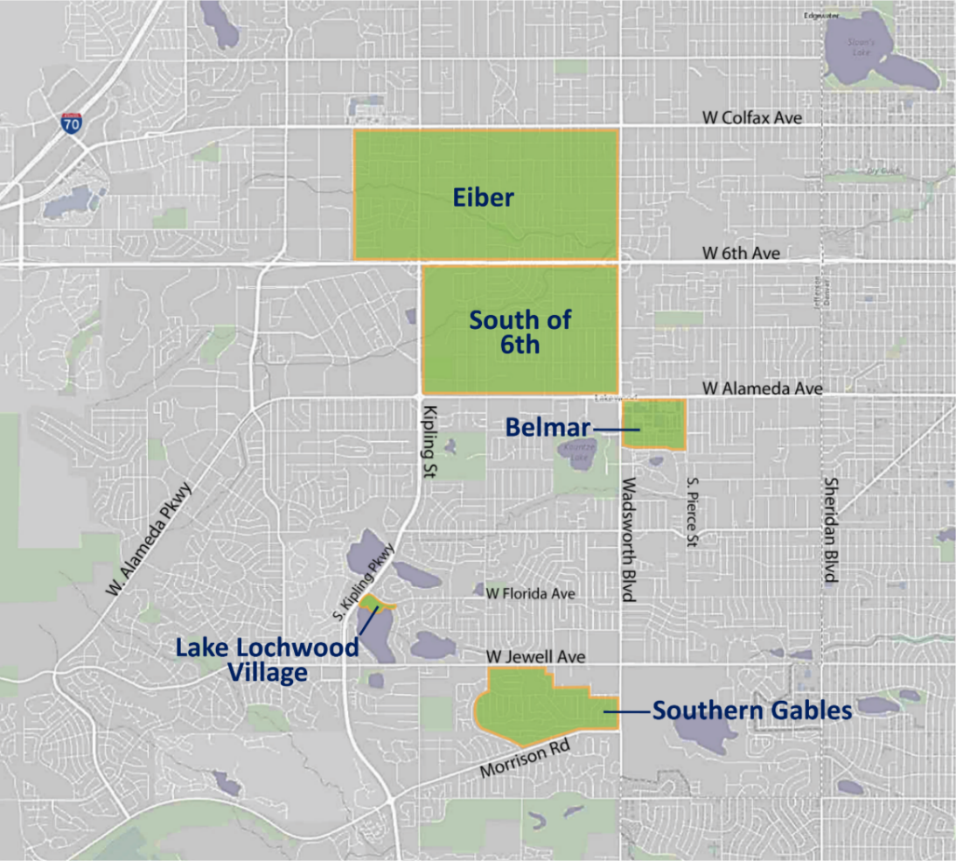
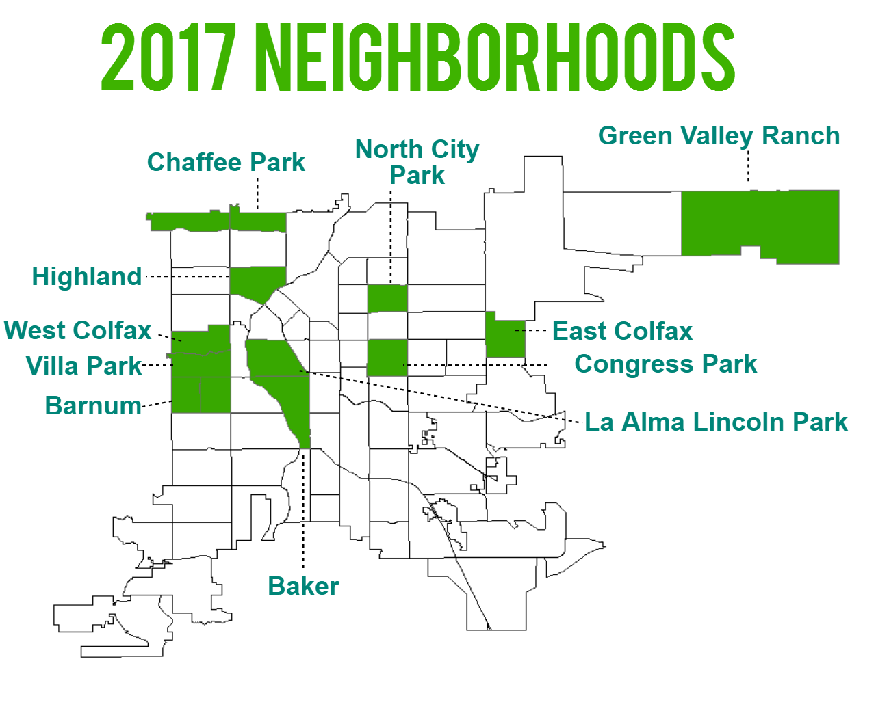
Participating neighborhoods are a small share of the total
Pop. 147,000
Pop. 650,000
Lakewood started with stable neighborhoods to reduce risk of failure for an untested program
Denver is targeting low and moderate income neighborhoods and communities of color

Slide 11
Why study this?
Appropriate scale to promote sustainability
Community Development
Democracy is in trouble…local government is the answer
“Individuation” of climate change
If states won’t sustain citizens, cities will
Eco-localisation
People don’t know their neighbors
“responsibilization” of the consumer
Climate pledges and guilt
Divides stem from isolation and self sorting
Can social Marketing work?
City-led Sustainability Systems, e.g. STAR Communities
Why do the same people engage?
What about class, race, and gender

Slide 12
Research Approach
What are the direct and ancillary benefits of the SNN?
Is this a sustainable model?
Is it scalable & replicable?
Who participates?
Is it effective?
Why?
3 Year study
Analysis of project database
  10 Neighborhoods (5 from each city; minimum of 2 years in program)
Participant observation through “RA/Interns”
Interviews with staff and residents
Online survey open to city residents
$4,000 in small grants from CU Denver

Slide 13
FINDINGS
Direct and Ancillary

Slide 14
The Numbers: 10 neighborhoods (2012-2016)
Is it improving sustainability? Whose Participating?
Lakewood Project Goals | Projects | Credits | Direct Participants
People | 159 | 489
Land, People | 52 | 161
Energy, Air, Water, Land, People | 31 | 143
Land | 27 | 56
Energy | 22 | 51
Energy, Air, People | 18 | 120
Air, Water, Land, People | 14 | 46
Energy, People | 11 | 32
N/AV | 9 | 8
Water | 8 | 18
Water, Land, People | 8 | 34
Air, People | 6 | 18
Energy, Land, People | 5 | 14
Air, Land, People | 4 | 10
Energy, Air, Water, Land | 4 | 8
Water, People | 4 | 20
Energy, Air | 3 | 4
Energy, Air, Land, People | 3 | 28
Air, Land | 2 | 6
Energy, Land | 1 | 4
Energy, Water, Land | 1 | 0
Air, Water, Land | 1 | 0
 | 393 | 1270 | 52
Denver Project Goals | Projects | Credits | Direct Participants
People | 73 | 305
Land, People | 49 | 202
Energy, Air, Water, Land, People | 28 | 146
Water, Land, People | 9 | 28
Energy | 6 | 12
N/AV | 5 | 10
Energy, Land, People | 5 | 28
Water, Land | 5 | 10
Energy, Air, Land, People | 4 | 18
Land | 4 | 14
Energy, Air | 3 | 9
Air, People | 2 | 0
Energy, Land | 2 | 0
Energy, People | 2 | 0
Energy, Water, Land, People | 2 | 0
Air, Water, Land, People | 1 | 4
Energy, Air, People | 1 | 0
Energy, Air, Water | 1 | 0
Energy, Air, Water, People | 1 | 0
 | 203 | 786 | 47

Slide 15
From the residents:
People have significantly changed behaviors: education, awareness, tools, camaraderie
  “What does sustainability mean to me? “Well there’s the classic UN definition, but …”
Connecting people to others who are “like-minded”
Creates its own momentum: In Lakewood, “We don’t want the government to solve all of our problems, even if they could”
  Ownership and empowerment
Involvement in other city goals
Citizens are emotionally invested
Respect and admiration for the city planners leading their SN program

Slide 16
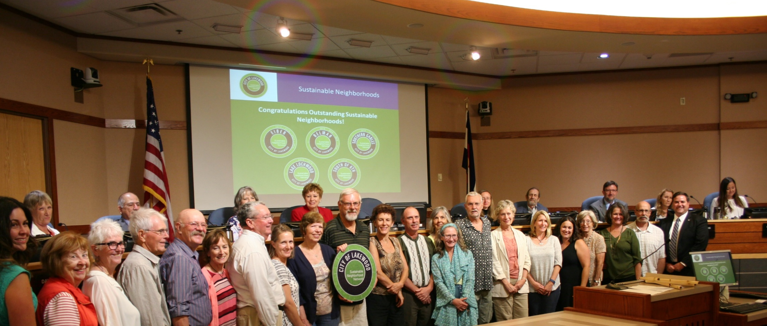
“This Sustainable Neighborhood Program is one of the best community building ideas that government has ever come up with. And I think it reminds us that we should all be better stewards of the land. Everything these folks do makes our planet healthier. Thank you.”- Councilmember Charley Able, Ward 1
“The programs that you’re doing are meaningful, and they are going to make a difference in our next generation here in our city. But really, what is important, and what impresses me the most is that the people that are on a day-to-day basis giving your time, talent, and stepping to the table to be present for this community. You are what makes Lakewood, Lakewood.” –Councilmember Ramey Johnson, Ward 1
“The key to this program is not only making a difference in your community, but it is getting together and knowing your neighbor and building the community. That has been so special and we heard over and over tonight about how getting out and meeting folks and having an exchange of ideas has been so healthy. And that is what this program is all about. So thank you all.” –Mayor Adam Paul

Slide 17
Discussion: Successes & Challenges
Affordable, equitable, practical, effective, enduring, wide-reaching, reliable, and scalable to other places?

Slide 18
Strengths
Civic Engagement beyond SNN:
from SN to City Council
Access to businesses & nonprofits
Neighbors like sharing ideas with other neighborhoods
Positive Individuation of Climate Change
Neighborhoods aren’t using it to wield power or steer other funding
Politicians are learning bout and embracing sustainability
City is a hub for resources, continuity, and
“re-launches”
Promotes inter-agency problem solving

Slide 19
Weaknesses
Nonprofits informally involved for capacity in LI neighborhoods, but no funding
Reliance upon unique inside-advocate planners who are passionate, patient, rational, cautious and strategic: what if they leave?
Institutional Hesitance: Agencies and politicians love it: but hesitant to fully fund it
Reproducing hierarchies within and across neighborhoods: Equity goal but most leaders are SF homeowners
Seen as fluff by some but not the majority

Slide 20
Opportunities
Developing, tapping, and strengthening informal and relational networks across sectors
Other agencies eager to tap into SN for citizen outreach and support, e.g. implement HIA actions
Neighborhood Demand exists: many want to do more and bigger projects and beyond neighborhoods
Utility and “Green” businesses want to access SNs
(SN makes sure they don’t market to residents)
New simplified credit system
Steer/Nudge SN toward
Denver’s 3 Big Goals:
Community Resilience
Net Zero
Mobility

Slide 21
Threats
Another thing privileged white people do
Certain efforts institutionally favor SF homeowners
Neighbor frustration from lack of resources, direction, and organization from City
Avoidance of political issues and approaches
2-year funding cycle: Denver planner may be “poached”
Decision making and volunteering: cultural, race, and class divides

Slide 22
What’s Next?
?
Will Denver’s steering be embraced by neighborhoods?
Will Denver’s neighborhood grants improve equity?
Will freezing Denver neighborhoods improve responsiveness/organization?
Will Lakewood’s FTE be renewed?
Will project types become more sophisticated?
Will more cities join?

Slide 23
Take-aways
This program has found a sweet spot between government led on the one hand and social movement or privatization on the other. Government hasn’t left the building (privatization) nor have the groups tried to influence the government for personal gain
Two-way learning
Ripple effect is immeasurable
Find ways to involve residents in non-participating neighborhoods
Keep the market at-bay: once they’re involved they would begin shifting things toward their way, which ultimately would lead to exclusion and bias toward things that earn them more capital
Support ongoing, even increased, government support
Accountability through the re-launches and point system

Slide 24
Other structures to pursue
Governance arrangements are based on a common and distinctive set of features:
Horizontal interaction among presumptive equal participants without distinction between their public or private status.
Regular, iterative exchanges among a fixed set of independent but interdependent actors.
Guaranteed (but possibly selective) access, preferably as early as possible in the decision-making cycle.
Organized participants that represent categories of actors, not individuals (Schmitter, 2000, p. 4).

